Slide 1
Elizabeth Cady Stanton: Class Privilege and Gender Oppression
History 350
May 7, 2015

Slide 2
Announcements
The second discussion forum closes on Tuesday, May 12 at 11:59 p.m.
The third discussion forum question (on Cady Stanton and the women’s rights movement) is now available on Blackboard. The deadline for posts is 11:59 p.m. May 28.
Study questions on Vivian Gornick, The Solitude of Self, are now online here.
We’re hoping to have your midterms graded and ready to return to you in class on Tuesday (May 12).

Slide 3
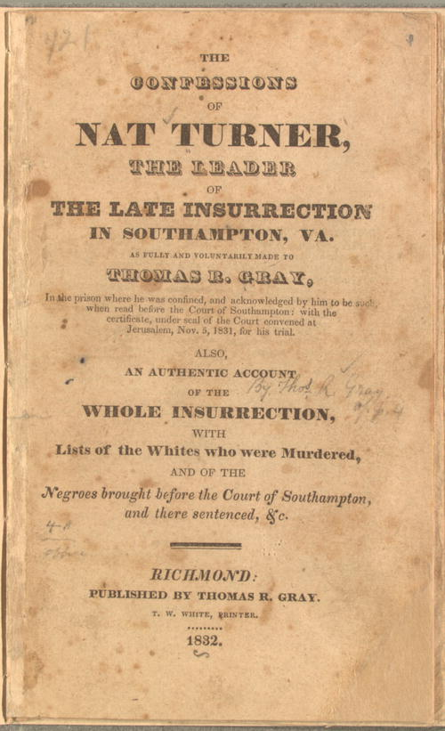
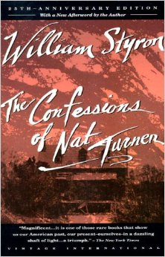
“Confessions” vs. Confessions
For those considering Option #3 (“History and Fiction—Nat Turner”) for your paper, I want to clarify: The “Confessions of Nat Turner” recorded by Thomas Gray in Turner’s jail cell in 1831 is not what you need to read for this paper topic. (You should have read that for the midterm.) For the paper, you need to read William Styron’s 1967 novel (a work of fiction) which has the same title: The Confessions of Nat Turner.
NO YES

Slide 4
Some Websites of Interest
Seneca Falls National Historical Park site on the origins of the women’s rights movement
Brief biographical sketch of Elizabeth Cady Stanton from National Women’s Hall of Fame
Not for Ourselves Alone—PBS/Ken Burns documentary on Stanton and Susan B. Anthony
Website for the edition of the Stanton-Anthony papers
The Grimke Sisters and Theodore Dwight Weld debate women’s role in the abolition movement

Slide 5
From Nat Turner to Elizabeth Cady Stanton
The next few slides conclude the section of the course on Nat Turner, discussing anti-slavery, issues of violence and the coming of the Civil War thirty years after his revolt.
These will also help frame the next course section, on Elizabeth Cady Stanton and the women’s rights movement. The relationship between anti-slavery and women’s rights movements in the nineteenth century has important parallels to the relationship between the Civil Rights Movement and the so-called “Second Wave” of feminism in the mid and late twentieth century.

Slide 6
Garrison, Pacifism and Anti-Slavery
Garrison: “This nation is destined to perish because in wading through blood and carnage to independence, it at the outset discarded the Prince of Peace, and elected George Washington to be its Savior….It is a fruitless attempt at self-government, totally distinct from the government of God in Jesus Christ….”
Moral suasion, anti-slavery and anti-racism

Slide 7
Anti-Slavery: Frederick Douglass, Violence and Resistance to Slavery
“Slaveholders have no rights more than any other thief or pirate. They have forfeited even the right to live, and if the slave should put every one of them to the sword tomorrow, who dare pronounce the penalty disproportionate to the crime?”

Slide 8
Anti-Slavery: Frederick Douglass on Violence as a Failing Strategy
1847 “The slave is in the minority, a small minority, the oppressors are an overwhelming majority….The one is weak; the other is strong….With the facts of our condition before us, it is impossible for us to contemplate any appeal to the slave to take vengeance on his guilty master, but with the utmost reprobation. Your committee regard any counsel of this sort as the perfection of folly, suicidal in the extreme, and abominably wicked.”

Slide 9
The “Slave Power” and the Extension of Slavery’s Reach
In the forty years before the Civil War, conflict over the expansion of slavery in the West threatened national unity. Before 1861, political compromises patched up the controversies.
Fearing they were under antislavery attack, Southern slaveholders became more aggressive in seeking protections for slavery and opportunities to expand.
This in turn ignited Northern fears that the entire nation would come under the domination of slaveholders—the “Slave Power.” This led in 1854 to the formation of the Republican Party, committed to slowing or stopping the spread of slavery.
In 1850, a Congressional compromise strengthened the Fugitive Slave Act, making it easier for slaveholders to capture escaped slaves and return them to bondage.

Slide 10
Resisting the Recapture of Fugitives: Anthony Burns, Boston 1854
Anthony Burns had escaped from Virginia to Boston in 1854. When he was recaptured, a large crowd attempted to rescue him but failed. Reportedly, 50,000 Bostonians watched him returned to slavery.

Slide 11
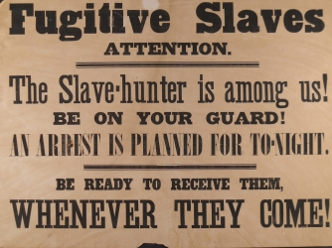

Slide 12
Douglass: “The True Remedy for the Fugitive Slave Bill”
Following the Anthony Burns recapture, 1854:
“A good revolver, a steady hand, and a determination to shoot down any man attempting to kidnap. Let every colored man make up his mind to this and live by it, and if needs be, die by it. This will put an end to kidnapping and to slaveholding, too.”
“Oh! That we had a little more of the manly indifference to death which characterized the Heroes of the American Revolution.”

Slide 13
John Brown and the Harper’s Ferry Raid 1859
John Brown’s longstanding hatred of slavery grew into a conviction that it was his duty to attempt to launch and lead a slave revolution.
Despite his personal eccentricities, he convinced some leading opponents of slavery to support him, though he didn’t reveal his plan’s specifics to them.
Frederick Douglass was one of the “Secret Six” who backed Brown.

Slide 14
John Brown and the Harper’s Ferry Raid 1859
In October 1859, Brown and a handful of associates launched a raid on a U.S. armory in northern Virginia, hoping to provoke a slave uprising.
In about two days, U.S. troops crushed the uprising and captured Brown.
Before Brown was executed, he became a hero to many in the North for his display of courage and commitment in opposing the “slave power.”
A year later, Abraham Lincoln was elected President. Eleven states seceded and the Civil War began in April 1861.
U.S. Marines led by Colonel Robert E. Lee smash down the entrance to the arsenal where
John Brown and the other raiders had seized.

Slide 15
Women in 19th Century America
Demography
Average lifetime number of births for women of childbearing age.
1800: 7.04
1900: 3.56
[1960: 3.53]
[2000: 2.05]
What implications for women’s lives and women’s public activism?

Slide 16
“Separate Spheres” for Men and Women?
“In no country has such constant care been taken as in America to trace two clearly distinct lines of action for the two sexes and to make them keep pace one with the other, but in two pathways that are always different. American women never manage the outward concerns of the family or conduct a business or take a part in political life; nor are they, on the other hand, ever compelled to perform the rough labor of the fields or to make any of those laborious efforts which demand the exertion of physical strength. No families are so poor as to form an exception to this rule. If, on the one hand, an American woman cannot escape from the quiet circle of domestic employments, she is never forced, on the other, to go beyond it.”--Alexis de Tocqueville more from Tocqueville about American women
Was Tocqueville correct?

Slide 17
Women’s “Nature”
“The Cult of True Womanhood” (the title of an influential article published in 1966 by historian Barbara Welter) described a set of nineteenth-century assumptions about women’s inherent nature.
Piety
Purity
Domesticity
Submissiveness
Which women might this apply to?
Did women’s lives actually fit these prescriptions for them?

Slide 18
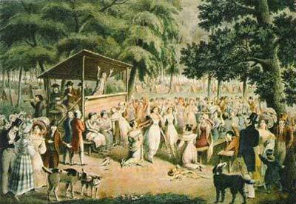
Sources of the Women’s Rights Movement: Religious Revivalism
The Second Great Awakening 1820s-30s
Conscience and Salvation
“Be ye therefore perfect, even as your Father which is in heaven is perfect.”
Male ministers, female congregations
At right: Open-air revival
Meeting.

Slide 19
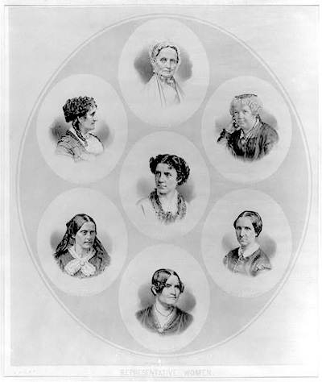
Sources of the Women’s Rights Movement (continued)
Temperance
Antislavery
At right: Notable women in the abolitionist and women’s rights movements of the 19th century. Lucretia Mott, Grace Greenwood, Elizabeth Cady Stanton, Anna Dickinson, Mary Livermore, Susan B. Anthony, and Lydia Maria Child.

Slide 20
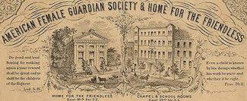
Sources of the Women’s Rights Movement: Moral Reform
Anti-prostitution movement
Middle-class women in public roles
Criticizing male behavior
Women’s solidarity across class and cultural divides

Slide 21
Sources of the Women’s Rights Movement: Solidarity and Sisterhood
Susan B. Anthony—Elizabeth Cady Stanton’s bff
Women’s Friendships and Social Activism
“Boston Marriages”
The L-Word: Does it matter?

Slide 22
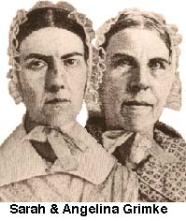
Women and Abolitionism
Women’s Role and Women’s Rights
Sarah and Angelina Grimke
The Grimke Sisters: Wealthy and Powerful South Carolina Slaveholding Family
Conversion and Commitment to Anti-Slavery
Controversy over Angelina Grimke as anti-slavery lecturer: “The time to assert a right is the time when that right is denied.”
1840: American Anti-Slavery Society divides over women’s roles

Slide 23
Elizabeth Cady Stanton 1815-1902
Becoming Elizabeth Cady
Cady Family Home, Jamestown, New York
Privilege and Limitations
Education for what?
An environment of conservatism and stirrings of reform

Slide 24
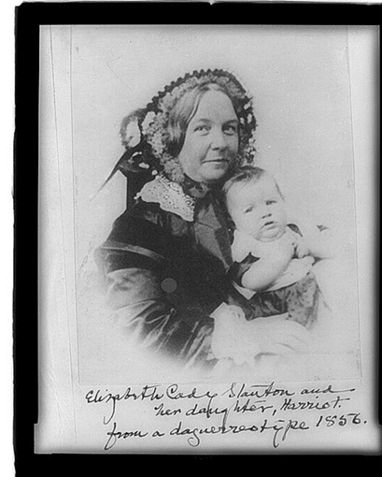
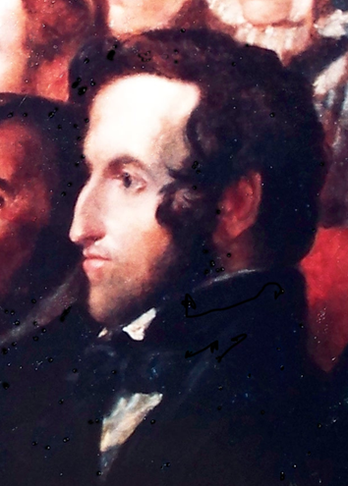
Becoming Mrs. Henry B. Stanton
"We lived together without more than the normal matrimonial friction for more than half a century.“
Elizabeth Cady Stanton in her autobiography
“Henry greatly needs a humble, holy companion, and she needs the same.”
London Honeymoon
Building a family
Henry Brewster
Stanton 1840

Slide 25
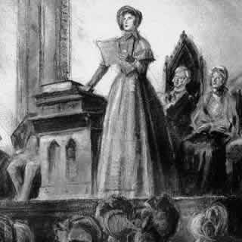
The Origins of the Women’s Rights Movement
Seneca Falls: Domesticity and Activism
The Declaration of Sentiments
Preamble: We hold these truths to be self-evident: that all men and women are created equal; that they are endowed by their Creator with certain inalienable rights;
The Convention and the Demand for Suffrage: “Now, in view of this entire disfranchisement of one-half the people … and because women do feel themselves aggrieved, oppressed, and fraudulently deprived of their most sacred rights, we insist that they have immediate admission to all the rights and privileges which belong to them as citizens of the United States.”
Seneca Falls Women’s Rights Convention July 19-20, 1848

Slide 26
Seneca Falls Declaration and Resolutions
Women’s Roles and Women’s Rights
What did women want?
Which women?
How to gain equality?
State Women’s Rights Conventions
The difficulties of organizing
“In entering upon the great work before us, we anticipate no small amount of misconception, misrepresentation, and ridicule; but we shall use every instrumentality within our power to effect our object. We shall employ agents, circulate tracts, petition the State and National legislatures, and endeavor to enlist the pulpit and the press in our behalf. We hope this Convention will be followed by a series of Conventions embracing every part of the country.”
Why “ridicule”?

