Slide 1
Radical Labor and the Road to Haymarket Square
History 350
May 28, 2015

Slide 2
Announcements
The final exam is scheduled for Monday, June 8 at 12:30. I’ll have instructions and potential essay questions by the end of this week.
The exam will emphasize the second half of the course but will be comprehensive.
There will be a take-home option. The take-home will be due by the start of the in-class version. If you’re not finished with the take-home, you must take the in-class exam.
The take-home will be all essay. The in-class will be essays plus IDs.
The third discussion forum question (on Cady Stanton and the women’s rights movement) is now available on Blackboard. The deadline for posts is 11:59 p.m. tonight.
The fourth forum question (on radical labor) is now available. The deadline for posts is 11:59 p.m. Wed., June 10.

Slide 3
Announcements (continued)
Study questions on Martin Duberman, Haymarket are now online here.
The paper is due by class time on May 26 NEW! TODAY, May 28. The topic options and instructions are available on Blackboard. Late papers will be accepted through June 4 but penalized one grading notch (e.g. from a B to a B-) for every weekday it’s late.
Submit hard copy to me or Feather. If you need to submit it electronically, let me know why and get my authorization. Follow up as soon as possible with hard copy.

Slide 4
Some Websites of Interest
PBS American Experience documentary Chicago: City of the Century website—note the section on anarchists.
The Great Railroad Strike of 1877 video (12 min.)
Preamble and Declaration of Principles of the Knights of Labor
Excerpts from Chicago: City of the Century on Haymarket affair: part 1 part 2 part 3 (about 15 min. total)
An archive of material on Haymarket. (This is part of a massive “Anarchy Archives”— “an online research center on the history and theory of anarchism”.
An extensive site on “The Dramas of Haymarket”

Slide 5
Unions in Gilded Age America
The Knights of Labor (founded 1869)
Fraternity and Harmony
Membership excludes only lawyers, doctors, bankers, liquor sellers, professional gamblers and stockbrokers
Demands "education, cooperation and political action and through these the abolition of the wage system."

Slide 6
American Federation of Labor
The American Federation of Labor (AFL) founded 1886
AFL Declaration of Principles
Accepting the capitalist system
Demanding “More”
Trade (or crafts) unionism
Skilled workers
Strategy of controlling supply of labor
“Whereas a struggle is going on in the nations of the civilized world, between the oppressors and oppressed of all countries, a struggle between capital and labor which must grow in intensity from year to year and work disastrous results to the toiling millions of all nations, if not combined for mutual protection and benefits.. . . To protect the skilled labor of America from being reduced to beggary and to sustain the standard of American workmanship and skill, the trades unions of America have been established.”

Slide 7
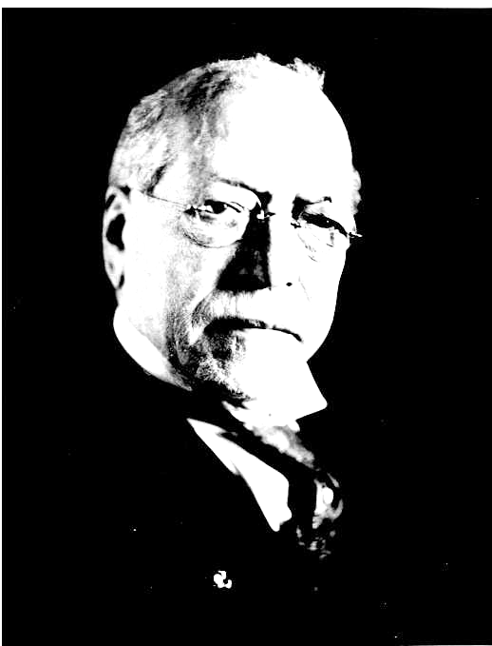
The AFL and the Capitalist System
Samuel Gompers: Leader of the American Federation of Labor 1886-1924
“I have come to the conclusion . . . that it is our duty to live our lives as workers in the society in which we live, and not to work for the downfall or the destruction or the overthrow of that society, but for the fuller development and evolution of the society in which we live; to make life the better worth living. “

Slide 8
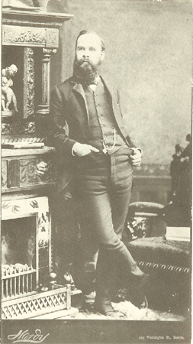
“The American as Anarchist”
Individualist anarchism
“Disobedience is the true foundation of liberty. The obedient must be slaves.”—Henry David Thoreau
“The only security men can have for their political liberty, consists in keeping their money in their own pockets.”—Lysander Spooner
“Aggression is simply another name for government. Aggression, invasion, government, are interconvertible terms. The essence of government is control, or the attempt to control.”—Benjamin Tucker
At right: Benjamin Tucker, Individualist Anarchist author and journalist 1854-1939.

Slide 9
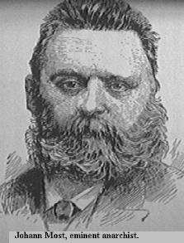
“The Alien as Anarchist”?
Marxism and Anarchism: Karl Marx vs. Mikhail Bakunin
At right: Johan Most, German-American anarchist
Most called for “propaganda of the deed”—attentats in German—acts of violence aimed at
provoking worker uprising.
New York Times describes him: “Most was seedy. He wore a black suit, the coat an abbreviated Prince Albert, greasy and glossy and whitened with cigar ashes, a buff waistcoat buttoned almost to his throat, and a cheap ventilated white straw hat pushed back from his bald forehead. His puffed face was a dull, dead red where it could be seen through his grizzled beard. He seemed to be more interested in the settlement of the beer account than in anything that developed during the day.”

Slide 10
The “Pittsburgh Manifesto” 1883
FELLOW-WORKMEN: The Declaration of Independence says:
“…But when a long train of abuses and usurpations, pursuing invariably the same object, evinces a design to reduce them (the people) under absolute Despotism, it is their right, it is their duty to throw off such government and provide new guards for their future security.”
This thought of Thomas Jefferson was the justification for armed resistance by our forefathers, which gave birth to our Republic, and do not the necessities of our present time compel us to reassert their declaration? . . .
Our present society is founded on the exploitation of the propertyless classes by the propertied. This exploitation is such that the propertied (capitalists) buy the working force body and soul of the propertyless. . . .

Slide 11
“Pittsburgh Manifesto” continued
The political institutions of our times are the agencies of the propertied class; their mission is the upholding of the privileges of their masters; any reform in your own behalf would curtail these privileges. To this they will not and cannot consent, for it would be suicidal to themselves.
That they will not resign their privileges voluntarily we know; that they will not make any concessions to us we likewise know. Since we must then rely upon the kindness of our masters for whatever redress we have, and knowing that from them no good may be expected, there remains but one recourse - FORCE! Our forefathers have not only told us that against despots force is justifiable, because it is the only means, but they themselves have set the immemorial example.
By force our ancestors liberated themselves from political oppression, by force their children will have to liberate themselves from economic bondage. “It is, therefore, your right; it is your duty,” says Jefferson - “to arm!”

Slide 12
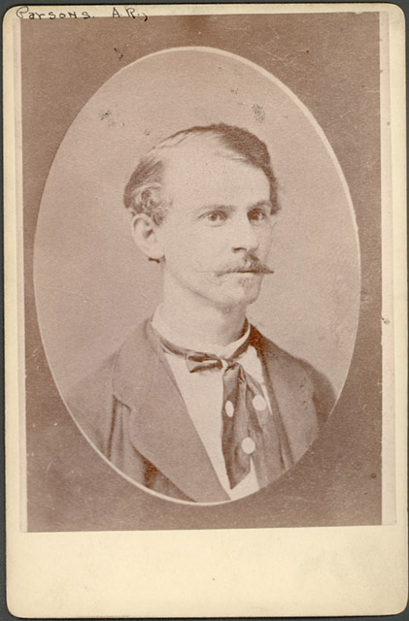
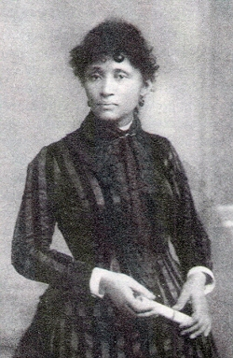
Albert and Lucy Parsons

Slide 13
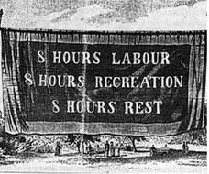
The Eight Hour Day Movement

Slide 14
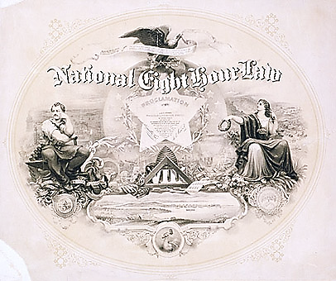

Slide 15
Eight Hour Day Song
We mean to make things over, We are tired of toil for naught With but bare enough to live upon And ne'er an hour for thought. We want to feel the sunshine And we want to smell the flow'rs We are sure that God has willed it And we mean to have eight hours; We're summoning our forces From the shipyard, shop and mill Eight hours for work, eight hours for rest Eight hours for what we will; Eight hours for work, eight hours for rest Eight hours for what we will.
More lyrics and the tune here

Slide 16
Eight Hour Day Parade: May 1

Slide 17
Map: “Labor Unrest in Chicago, April 25-May 4, 1886”
[Link for the map: http://www.encyclopedia.chicagohistory.org/pages/1769.html]

Slide 18
McCormick Reaper Works: May 3

Slide 19
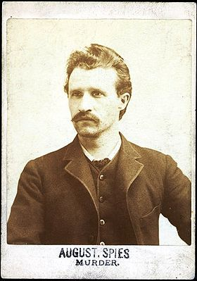
The Revenge Circular

Slide 20
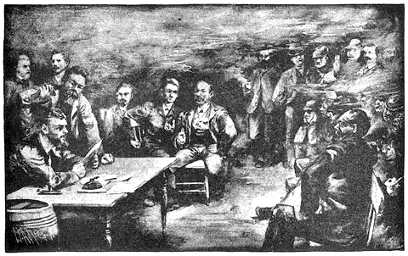
A Conspiratorial Meeting?

Slide 21
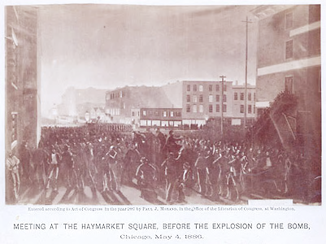
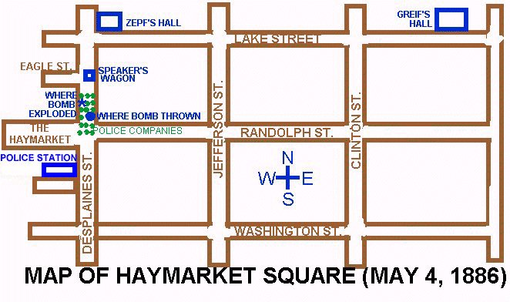
The Protest and the Bomb

Slide 22
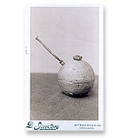
The Bomb—People’s Exhibit 129a

Slide 23
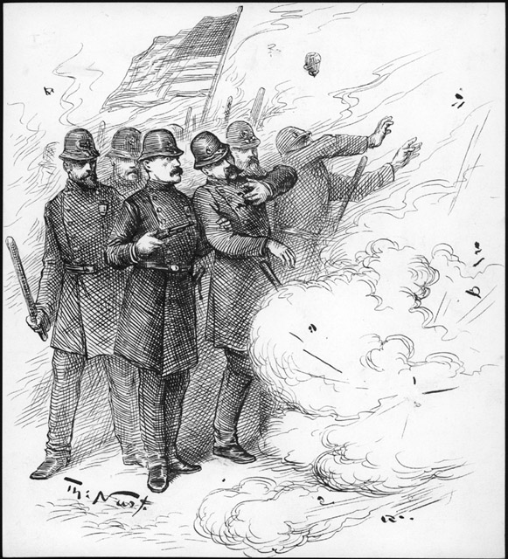
Cartoon Depiction of the Bombing

Slide 24
Martial Law

Slide 25
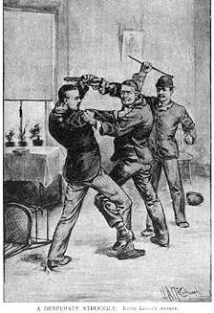
Arresting Louis Lingg

Slide 26
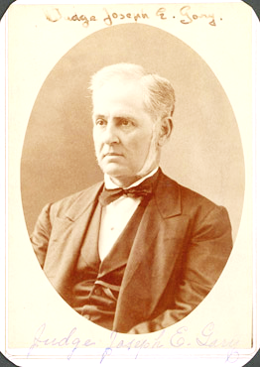
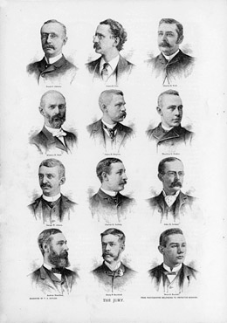
The Trial: Judge and Jury

Slide 27
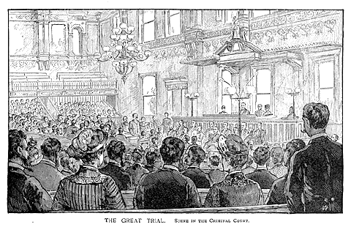
The Courtroom

Slide 28
Juror Selection: Juror accepted for service

Slide 29
Instructions to the Jury

Slide 30
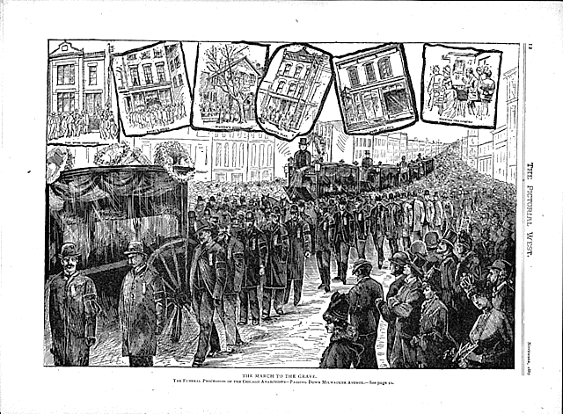
The March to the Grave, Nov. 13, 1887

Slide 31
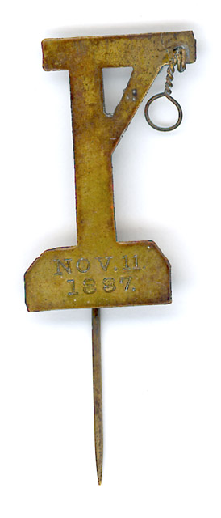
Gallows Pin Worn by Opponents of the Executions

Slide 32
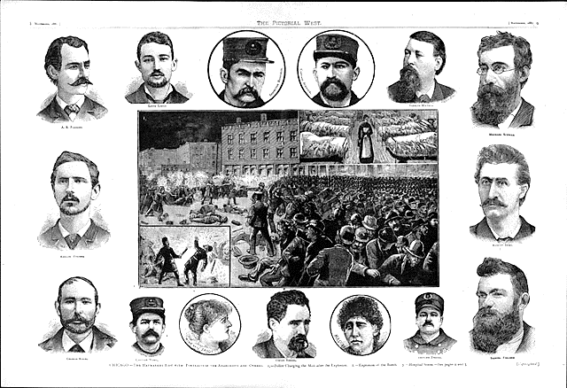
A Souvenir Photograph for You

