Slide 1
American Industrialization and American Labor
History 350
May 26, 2015

Slide 2
Announcements
The final exam is scheduled for Monday, June 8 at 12:30. I’ll have instructions and potential essay questions by the end of this week.
The exam will emphasize the second half of the course but will be comprehensive.
There will be a take-home option. The take-home will be due by the start of the in-class version. If you’re not finished with the take-home, you must take the in-class exam.
The take-home will be all essay. The in-class will be essays plus IDs.
The third discussion forum question (on Cady Stanton and the women’s rights movement) is now available on Blackboard. The deadline for posts is 11:59 p.m. Thursday May 28.

Slide 3
Announcements (continued)
Study questions on Martin Duberman, Haymarket are now online here.
The paper is due by class time on May 26 NEW! This Thursday, May 28. The topic options and instructions are available on Blackboard. Late papers will be accepted through June 4 but penalized one grading notch (e.g. from a B to a B-) for every weekday it’s late.
Submit hard copy to me or Feather. If you need to submit it electronically, let me know why and get my authorization. Follow up as soon as possible with hard copy.

Slide 5
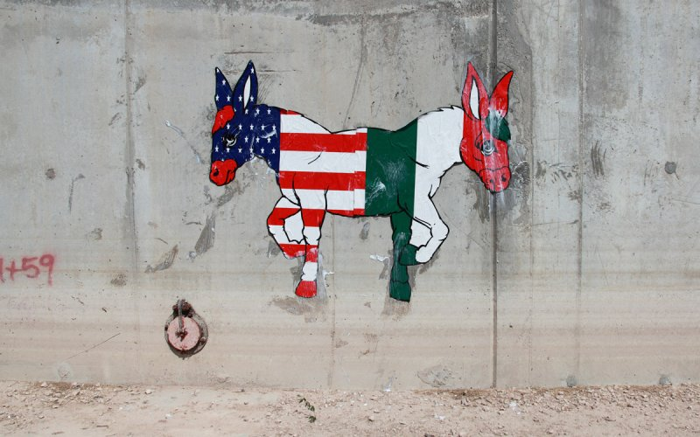
U.S./Mexico: Film and History
HIST 410
CRN 42135
6/22-7/19
12:00-1:50 mtwr
The relationship between the U.S and Mexico has been shaped by war, influenced by economic cooperation, understood through racialization, and re-imagined in film, literature, and the lived experiences of immigrants. The two countries are bound together by a vast border and divided by differing interpretations of a shared history. How have this relationship, its interpretations, and its representations changed over time? Class themes include conquest, race, capitalism, and immigration.

Slide 7
Some Websites of Interest
PBS American Experience documentary Chicago: City of the Century website—note the section on anarchists.
The Great Railroad Strike of 1877 video (12 min.)
Preamble and Declaration of Principles of the Knights of Labor
Excerpts from Chicago: City of the Century on Haymarket affair: part 1 part 2 part 3 (about 15 min. total)

Slide 8
American Industrialization and Radical Labor
We start our fourth section of the course here, on radical labor and the Haymarket events of 1886 and beyond. Here are a few issues and themes we’ll consider in the unit:
What role has violence played in the history of American radicalism?
What meaning did equality have for workers in late nineteenth century America? How does it compare with other forms of equality we’ve encountered this term?
What role did race and ethnicity play in the labor movement?
Politicians and others today often refer to “American Exceptionalism,” the idea that the U.S. is fundamentally different from other industrial or post-industrial capitalist societies. Does the history of American workers we’ll study support or challenge that view?

Slide 9
New Meanings for Independence and Equality
Toward a “nation of immigrants”
A “Gilded Age” of wealth and poverty
From family farmers to wage laborers
Equality of opportunity? Inequality of outcomes?

Slide 10
An 1886 Workers’ “Declaration of Independence”
“We hold these truths to be self-evident: that all men are created free and with equal rights; that they are endowed by their creator with certain inalienable rights, that among these are Life and the means of living, Liberty and the conditions essential to Liberty, Justice and the weapons for its enforcement, and with the right to the Pursuit of Happiness in all ways not inconsistent with the equal rights of other men.”

Slide 11
An 1886 Workers’ “Declaration of Independence” (continued)
“The history of the Millionaires who control the present government at Washington and their aristocratic and monopolistic followers in the states and territories is a history of repeated injuries and usurpations, all having in direct object the establishment of an absolute tyranny over the people of this republic.
“To prove this let facts be submitted to a candid world.” . . .

Slide 12
An 1886 Workers’ “Declaration of Independence” (continued)
“We therefore, the representatives of the wage workers and producers in this republic,…solemnly publish and declare:
“That the People of these Untied States of right ought to be FREE AND INDEPENDENT OF CLASS DOMINATION; that they are absolved from all moral allegiance to such laws and institutions as maintain and permit class slavery and public corruption; that to secure in fact the practice and enforcement of the principles of American Liberty is the FIRST duty of all honest men and women.”

Slide 13
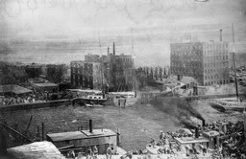
The Rise of Big Business
Railroads United the Nation
Manufacturing: Size, Speed and Scope
McCormick Reaper works burns
in the great Chicago fire of 1871.
McCormick rebuilds a bigger
factory.

Slide 14
Giant Cities
U.S. Urban Population:
1860: 6 million 20% of total
1900: 30 million 40% of total
[2010: 249 million or 81% of total]
Chicago Population
1840: 4470
1870: 298,977
1900: 1,698,575
[2010: 2, 695,598]

Slide 15
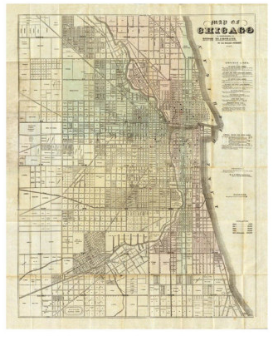
Chicago 1857 Chicago 1897

Slide 16
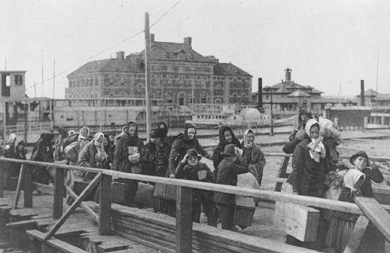
Immigration and a New Industrial Labor Force
Immigrants to United States:
1860: 153,000 1881: 669,000
1907 (Peak year): 1,285,000
Immigrants arrive
at Ellis Island, New York, 1902

Slide 17
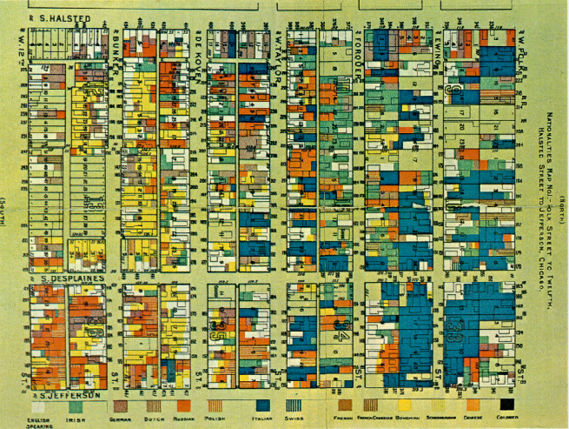
Immigration to Industrializing Chicago
1860: about half of Chicago’s population was foreign-born or children of foreign-born
1900: 79% foreign born or children of foreign-born
An 1895 map of different nationalities
in one working-class Chicago ward.

Slide 18
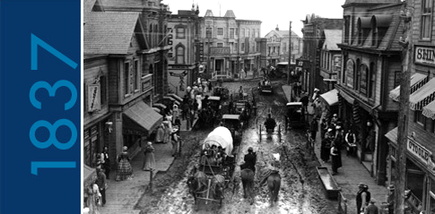
Chicago 1837

Slide 19
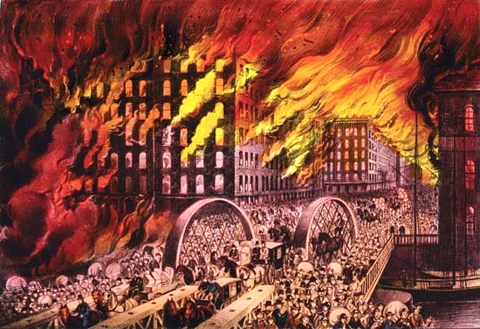
The Great Chicago Fire 1871

Slide 20
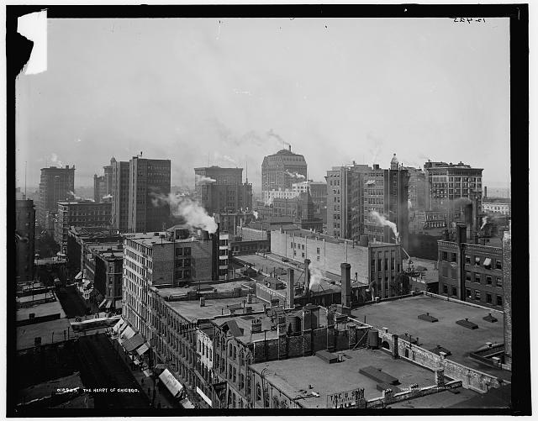
Center of Chicago 1900

Slide 21
Labor and “American Exceptionalism”
In 1905, German sociologist Werner Sombart compared the lifestyles of American and German workers in a book called Why Is There No Socialism in the United States?
The answer to his question in the title: “Roast Beef and Apple Pie”—American workers were too well off to want to change the capitalist system.
Other “exceptional” features of working-class America
Ethnic and racial divisions?
Equal citizens’ rights?
A frontier “safety valve”?

Slide 22
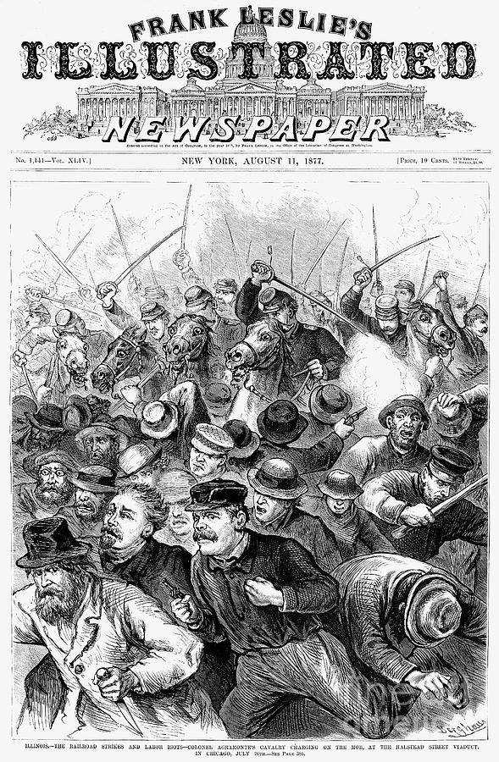
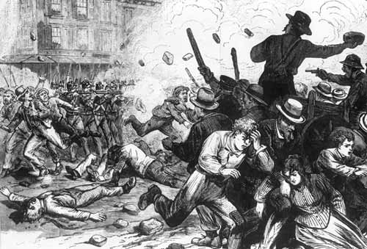
1877: The Great Railroad Strike
The Strike Begins: Martinsburg, West Virginia
Strike Battle in Chicago

Slide 23
Unions in Gilded Age America
The Knights of Labor (founded 1869)
Fraternity and Harmony
Membership excludes only lawyers, doctors, bankers, liquor sellers, professional gamblers and stockbrokers
Demands "education, cooperation and political action and through these the abolition of the wage system."

Slide 24
American Federation of Labor
The American Federation of Labor (AFL) founded 1886
AFL Declaration of Principles
Accepting the capitalist system
Demanding “More”
Trade (or crafts) unionism
Skilled workers
Strategy of controlling supply of labor
“Whereas a struggle is going on in the nations of the civilized world, between the oppressors and oppressed of all countries, a struggle between capital and labor which must grow in intensity from year to year and work disastrous results to the toiling millions of all nations, if not combined for mutual protection and benefits.. . . To protect the skilled labor of America from being reduced to beggary and to sustain the standard of American workmanship and skill, the trades unions of America have been established.”

Slide 25
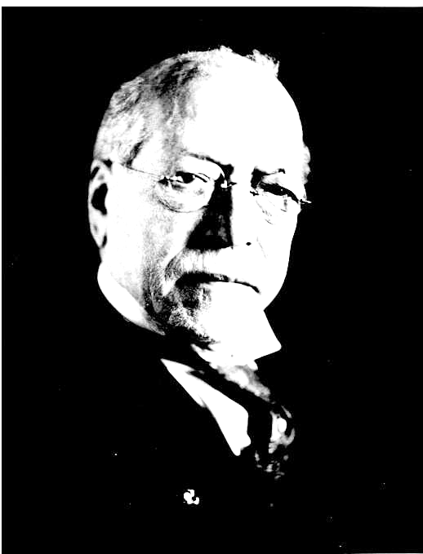
The AFL and the Capitalist System
Samuel Gompers: Leader of the American Federation of Labor 1886-1924
“I have come to the conclusion . . . that it is our duty to live our lives as workers in the society in which we live, and not to work for the downfall or the destruction or the overthrow of that society, but for the fuller development and evolution of the society in which we live; to make life the better worth living. “

Slide 26
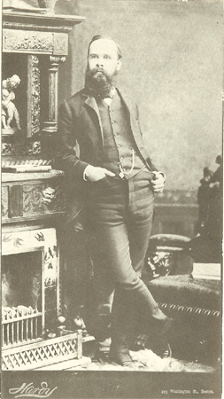
“The American as Anarchist”
Individualist anarchism
“Disobedience is the true foundation of liberty. The obedient must be slaves.”—Henry David Thoreau
“The only security men can have for their political liberty, consists in keeping their money in their own pockets.”—Lysander Spooner
“Aggression is simply another name for government. Aggression, invasion, government, are interconvertible terms. The essence of government is control, or the attempt to control.”—Benjamin Tucker
At right: Benjamin Tucker, Individualist Anarchist author and journalist 1854-1939.

Slide 27
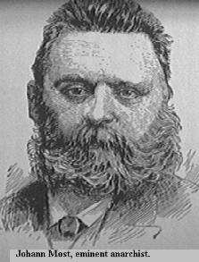
“The Alien as Anarchist”?
Marxism and Anarchism: Karl Marx vs. Mikhail Bakunin
At right: Johan Most, German-American anarchist
Most called for “propaganda of the deed”—attentats in German—acts of violence aimed at
provoking worker uprising.
New York Times describes him:“Most was seedy. He wore a black suit, the coat an abbreviated Prince Albert, greasy and glossy and whitened with cigar ashes, a buff waistcoat buttoned almost to his throat, and a cheap ventilated white straw hat pushed back from his bald forehead. His puffed face was a dull, dead red where it could be seen through his grizzled beard. He seemed to be more interested in the settlement of the beer account than in anything that developed during the day.”

Slide 28
The “Pittsburgh Manifesto” 1883
FELLOW-WORKMEN: The Declaration of Independence says:
“…But when a long train of abuses and usurpations, pursuing invariably the same object, evinces a design to reduce them (the people) under absolute Despotism, it is their right, it is their duty to throw off such government and provide new guards for their future security.”
This thought of Thomas Jefferson was the justification for armed resistance by our forefathers, which gave birth to our Republic, and do not the necessities of our present time compel us to reassert their declaration? . . .
Our present society is founded on the exploitation of the propertyless classes by the propertied. This exploitation is such that the propertied (capitalists) buy the working force body and soul of the propertyless. . . .

Slide 29
“Pittsburgh Manifesto” continued
The political institutions of our times are the agencies of the propertied class; their mission is the upholding of the privileges of their masters; any reform in your own behalf would curtail these privileges. To this they will not and cannot consent, for it would be suicidal to themselves.
That they will not resign their privileges voluntarily we know; that they will not make any concessions to us we likewise know. Since we must then rely upon the kindness of our masters for whatever redress we have, and knowing that from them no good may be expected, there remains but one recourse - FORCE! Our forefathers have not only told us that against despots force is justifiable, because it is the only means, but they themselves have set the immemorial example.
By force our ancestors liberated themselves from political oppression, by force their children will have to liberate themselves from economic bondage. “It is, therefore, your right; it is your duty,” says Jefferson - “to arm!”

Slide 30
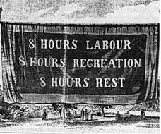
The Eight Hour Day Movement

Slide 31
Map: “Labor Unrest in Chicago, April 25-May 4, 1886”
[Link for the map: http://www.encyclopedia.chicagohistory.org/pages/1769.html]

