Slide 1
1. Stanton as Philosopher and as Outcast 2. American Industrialization and American Labor
History 350
May 21, 2015

Slide 2
Announcements
The final exam is scheduled for Monday, June 8 at 12:30. I’ll have instructions and potential essay questions by the end of next week.
The exam will emphasize the second half of the course but will be comprehensive.
There will be a take-home option. The take-home will be due by the start of the in-class version. If you’re not finished with the take-home, you must take the in-class exam.
The take-home will be all essay. The in-class will be essays plus IDs.
The third discussion forum question (on Cady Stanton and the women’s rights movement) is now available on Blackboard. The deadline for posts is 11:59 p.m. May 28. We plan to have forum #2 graded by the end of this week and will notify those with a “high pass” or a “no pass.”

Slide 3
Announcements (continued)
Study questions on Vivian Gornick, The Solitude of Self, are online here. Study questions on Martin Duberman, Haymarket are now online here.
The paper is due by class time on May 26 NEW! May 28. The topic options and instructions are available on Blackboard. As mentioned in class last Thursday, Feather and I are available to discuss your ideas for the paper and/or look at drafts and partially-completed papers—the sooner the better.

Slide 4
(Bad) Advice on the Paper
From “Zits” earlier this week:

Slide 6
U.S./Mexico: Film and History
HIST 410
CRN 42135
6/22-7/19
12:00-1:50 mtwr
The relationship between the U.S and Mexico has been shaped by war, influenced by economic cooperation, understood through racialization, and re-imagined in film, literature, and the lived experiences of immigrants. The two countries are bound together by a vast border and divided by differing interpretations of a shared history. How have this relationship, its interpretations, and its representations changed over time? Class themes include conquest, race, capitalism, and immigration.

Slide 7
Some Websites of Interest
PBS American Experience documentary Chicago: City of the Century website—note the section on anarchists.
The Great Railroad Strike of 1877 video (12 min.)
Preamble and Declaration of Principles of the Knights of Labor
Excerpts from Chicago: City of the Century on Haymarket affair: part 1 part 2 part 3 (about 15 min. total)
The classic statement of the contrast between “negative” and “positive” liberty, by philosopher Isaiah Berlin.

Slide 8
Success…and Failure of Women’s Suffrage?
After Women’s Suffrage, What Next?
A short history of the Equal Rights Amendment
Equality of rights under the law shall not be denied or abridged by the United States or by any State on account of sex.
Proposed 1923, passed by Congress in 1972, fails ratification (of 38 state legislatures needed to ratify, 35 had approved) in 1982
From Women’s Rights to Feminism
A Second Wave and a Third Wave…

Slide 9
Women’s Suffrage and Consumerism

Slide 10
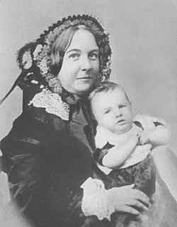
“A leader of thought rather than of numbers”
The radicalism of Cady Stanton
Cady Stanton seeks to end the “fourfold bondage of church, state, capital and society.”
Stanton with daughter Harriot, 1856

Slide 11
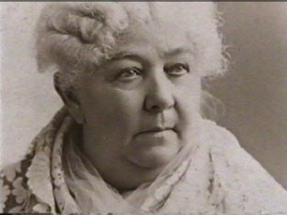
“The radical reform must start in our homes, in our nurseries, in ourselves.”
Divorce reform
Violence against women
Attacking the sexual “double standard”
Stanton late in life

Slide 12
Equality and Difference
Cady Stanton calls the idea of fundamental differences between men and women a “delusion”.
“There is no such thing as a sphere for sex.”
An “Amphiarchate” rather than an “aristocracy of sex”
But she also says, “As mothers of the race, there is a spiritual insight, a divine creative power that belongs to woman.”

Slide 13
Cady Stanton and the Solitude of Self
“Nothing adds such dignity to character as the recognition of one’s self-sovereignty.”
“The point I wish plainly to bring before you on this occasion is the individuality of each human soul--our Protestant idea, the right of individual conscience and judgment--our republican idea, individual citizenship.”
Feminist community and feminist individualism

Slide 14
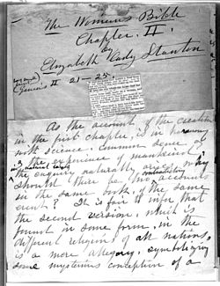
Religion and the Woman’s Bible
Cady Stanton as agnostic
“Bible historians claim special inspiration for the Old and New Testaments containing most contradictory records of the same events, of miracles opposed to all known laws, of customs that degrade the female sex of all human and animal life…and call all this ‘The Word of God.’”
Prays to “Mother and Father God”
“So perverted is the religious element in [woman's] nature, that with faith and works she is the chief support of the church and clergy; the very powers that make her emancipation impossible.”
“I know of no other books that so fully teach the subjection and degradation of woman.”

Slide 15
The Woman’s Bible and The Women’s Suffrage Movement
Susan B. Anthony opposes Stanton’s Bible project: “Of all her great speeches, I am always proud—but of her Bible commentaries, I am not proud—either of their spirit or letter ... But I shall love and honor her to the end.”
Woman’s Bible denounced at the 1896 National American Woman Suffrage Association convention: “As an organization we have been held responsible for the action of an individual ... in issuing a volume with a pretentious title, covering a jumble of comment ... without either scholarship or literary value, set forth in a spirit which is neither reverent nor inquiring.”
Convention disassociates itself from the Woman’s Bible
Stanton blames controversy on clergy: "Our politicians are calm and complacent under our fire but the clergy jump round the moment you aim a pop gun at them 'like parched peas on a hot skillet'"

Slide 16
American Industrialization and Radical Labor
We start our fourth section of the course here, on radical labor and the Haymarket events of 1886 and beyond. Here are a few issues and themes we’ll consider in the unit:
What role has violence played in the history of American radicalism?
What meaning did equality have for workers in late nineteenth century America? How does it compare with other forms of equality we’ve encountered this term?
What role did race and ethnicity play in the labor movement?
Politicians and others today often refer to “American Exceptionalism,” the idea that the U.S. is fundamentally different from other industrial or post-industrial capitalist societies. Does the history of American workers we’ll study support or challenge that view?

Slide 17
New Meanings for Liberty and Independence
Toward a “nation of immigrants”
A “Gilded Age” of wealth and poverty
From family farmers to wage laborers
Equality of opportunity? Inequality of outcomes?

Slide 18
An 1886 Workers’ “Declaration of Independence”
“We hold these truths to be self-evident: that all men are created free and with equal rights; that they are endowed by their creator with certain inalienable rights, that among these are Life and the means of living, Liberty and the conditions essential to Liberty, Justice and the weapons for its enforcement, and with the right to the Pursuit of Happiness in all ways not inconsistent with the equal rights of other men.”

Slide 19
An 1886 Workers’ “Declaration of Independence” (continued)
“The history of the Millionaires who control the present government at Washington and their aristocratic and monopolistic followers in the states and territories is a history of repeated injuries and usurpations, all having in direct object the establishment of an absolute tyranny over the people of this republic.
“To prove this let facts be submitted to a candid world.” . . .

Slide 20
An 1886 Workers’ “Declaration of Independence” (continued)
“We therefore, the representatives of the wage workers and producers in this republic,…solemnly publish and declare:
“That the People of these Untied States of right ought to be FREE AND INDEPENDENT OF CLASS DOMINATION; that they are absolved from all moral allegiance to such laws and institutions as maintain and permit class slavery and public corruption; that to secure in fact the practice and enforcement of the principles of American Liberty is the FIRST duty of all honest men and women.”

Slide 21
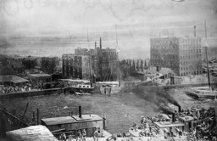
The Rise of Big Business
Railroads United the Nation
Manufacturing: Size, Speed and Scope
McCormick Reaper works burns
in the great Chicago fire of 1871.
McCormick rebuilds a bigger
factory.

Slide 22
Giant Cities
U.S. Urban Population:
1860: 6 million 20% of total
1900: 30 million 40% of total
[2010: 249 million or 81% of total]
Chicago Population
1840: 4470
1870: 298,977
1900: 1,698,575
[2010: 2, 695,598]

Slide 23
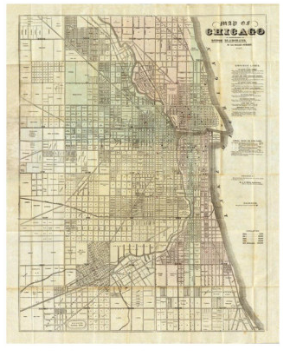
Chicago 1857 Chicago 1897

Slide 24
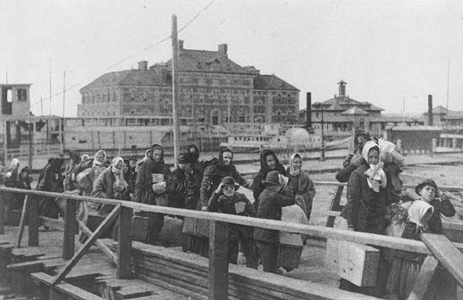
Immigration and a New Industrial Labor Force
Immigrants to United States:
1860: 153,000 1881: 669,000
1907 (Peak year): 1,285,000
Immigrants arrive
at Ellis Island, New York, 1902

Slide 25
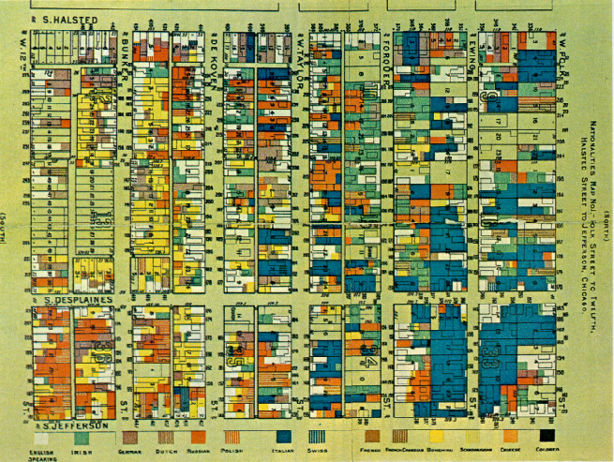
Immigration to Industrializing Chicago
1860: about half of Chicago’s population was foreign-born or children of foreign-born
1900: 79% foreign born or children of foreign-born
An 1895 map of different nationalities
in one working-class Chicago ward.

Slide 26
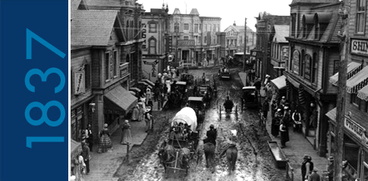
Chicago 1837

Slide 27
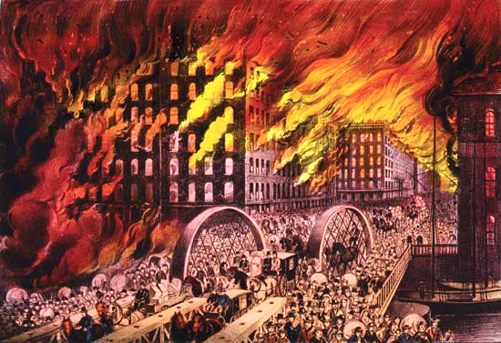
The Great Chicago Fire 1871

Slide 28
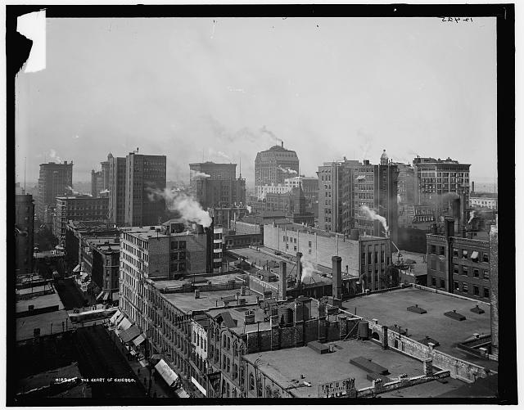
Center of Chicago 1900

Slide 29
Labor and “American Exceptionalism”
In 1905, German sociologist Werner Sombart compared the lifestyles of American and German workers in a book called Why Is There No Socialism in the United States?
His anwer: “Roast Beef and Apple Pie”—American workers were too well off to want to change the capitalist system.
Other “exceptional” features of working-class America
Ethnic and racial divisions?
Equal citizens’ rights?
A frontier “safety valve”?

Slide 30
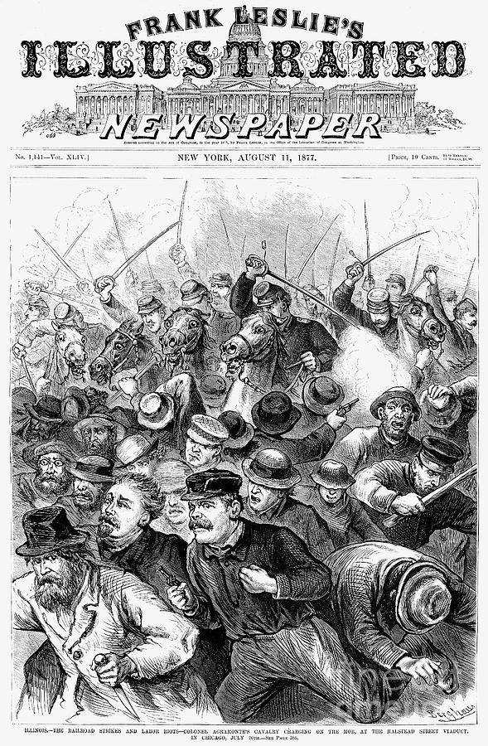
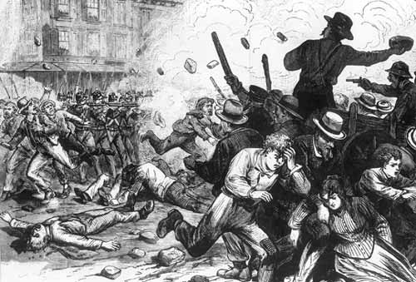
1877: The Great Railroad Strike
The Strike Begins: Martinsburg, West Virginia
Strike Battle in Chicago

Slide 31
Unions in Gilded Age America
The Knights of Labor (founded 1869)
Fraternity and Harmony
Membership excludes only lawyers, doctors, bankers, liquor sellers, professional gamblers and stockbrokers
Demands "education, cooperation and political action and through these the abolition of the wage system."

Slide 32
American Federation of Labor
The American Federation of Labor (AFL) founded 1886
AFL Declaration of Principles
Accepting the capitalist system
Demanding “More”
Trade (or crafts) unionism
Skilled workers
Strategy of controlling supply of labor
“Whereas a struggle is going on in the nations of the civilized world, between the oppressors and oppressed of all countries, a struggle between capital and labor which must grow in intensity from year to year and work disastrous results to the toiling millions of all nations, if not combined for mutual protection and benefits.. . . To protect the skilled labor of America from being reduced to beggary and to sustain the standard of American workmanship and skill, the trades unions of America have been established.”

Slide 33
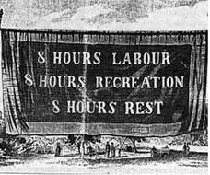
The Eight Hour Day Movement

