Slide 1
Women’s Rights and Freedmen’s Rights / Was women’s Suffrage a mistake? / Stanton as Philosopher and as Outcast
History 350
May 19, 2015

Slide 2
Announcements
The third discussion forum question (on Cady Stanton and the women’s rights movement) is now available on Blackboard. The deadline for posts is 11:59 p.m. May 28. We plan to have forum #2 graded by the end of this week and will notify those with a “high pass” or a “no pass.”
Study questions on Vivian Gornick, The Solitude of Self, are now online here.
The paper is due by class time on May 26 NEW! May 28. The topic options and instructions are available on Blackboard. As mentioned in class last Thursday, Feather and I are available to discuss your ideas for the paper and/or .look at drafts and partially-completed papers.

Slide 3
Hist. 410 : Piracy, Faith, and Seafaring in East Asia
Instructor : Erik Glowark (erik@uoregon.edu)
Summer I (6/22-7/19)
M-R 16:00-17:50
Satisfies East Asia, Pre-1800, and World History requirements.
Approved for Asian Studies.
Also fulfills multicultural requirements.
(Naval warfare during the Mongol invasion of Japan)
In this class we’ll explore the premodern world of merchants, missionaries (Buddhist and Christian), and “dwarf”-pirates who roamed the East China Sea looking for wealth, souls, and precious booty. We’ll also examine how maritime activity in 19th and 20th centuries, such as massive armadas of Chinese pirates and the formidable Imperial Japanese Navy, affected the emergence of a modern East Asia. See the online syllabus for more details.

Slide 4
Notes on Midterm
Summarizing what I said in class last Tuesday:
Average grade on essay was about B, slightly lower on IDs.
We recorded essay and ID grades separately. Essay is worth two-thirds of the exam.
Most people chose Essay 1 (on Paine) or 2 (Turner as madman).
IDs were worth a maximum of two points each, partial credit given. We added up your scores and translated the number to a letter grade as follows:
8.5-10=A 6.5-8=B 4.5-6=C 2.5-4=D 0-2=F

Slide 5
Some Websites of Interest
Seneca Falls National Historical Park site on the origins of the women’s rights movement
Brief biographical sketch of Elizabeth Cady Stanton from National Women’s Hall of Fame
Not for Ourselves Alone—PBS/Ken Burns documentary on Stanton and Susan B. Anthony
Website for the edition of the Stanton-Anthony papers
The Grimke Sisters and Theodore Dwight Weld debate women’s role in the abolition movement
Anthony got arrested for trying to vote in 1873. This site deals with her trial
Stanton, Anthony and Matilda Joslyn Gage wrote an enormous History of Women Suffrage in 1881. Here’s their account of the Seneca Falls conference.

Slide 6
The Scope of the Nineteenth Century Women’s Movement
Seneca Falls: Beyond suffrage in the Declaration of Sentiments
Having deprived her of this first right of a citizen, the elective franchise, thereby leaving her without representation in the halls of legislation, he has oppressed her on all sides.
He has made her, if married, in the eye of the law, civilly dead.
He has taken from her all right in property, even to the wages she earns.
He has so framed the laws of divorce, as to what shall be the proper causes of divorce; in case of separation, to whom the guardianship of the children shall be given; as to be wholly regardless of the happiness of women—the law, in all cases, going upon the false supposition of the supremacy of man, and giving all power into his hands.
After depriving her of all rights as a married woman, if single and the owner of property, he has taxed her to support a government which recognizes her only when her property can be made profitable to it.

Slide 7
Seneca Falls: Other Issues (continued)
He has monopolized nearly all the profitable employments, and from those she is permitted to follow, she receives but a scanty remuneration.
He closes against her all the avenues to wealth and distinction, which he considers most honorable to himself. As a teacher of theology, medicine, or law, she is not known.
He has denied her the facilities for obtaining a thorough education—all colleges being closed against her.
He allows her in Church as well as State, but a subordinate position, claiming Apostolic authority for her exclusion from the ministry, and, with some exceptions, from any public participation in the affairs of the Church.
He has created a false public sentiment, by giving to the world a different code of morals for men and women, by which moral delinquencies which exclude women from society, are not only tolerated but deemed of little account in man.
He has usurped the prerogative of Jehovah himself, claiming it as his right to assign for her a sphere of action, when that belongs to her conscience and her God.
He has endeavored, in every way that he could to destroy her confidence in her own powers, to lessen her self-respect, and to make her willing to lead a dependent and abject life.

Slide 8
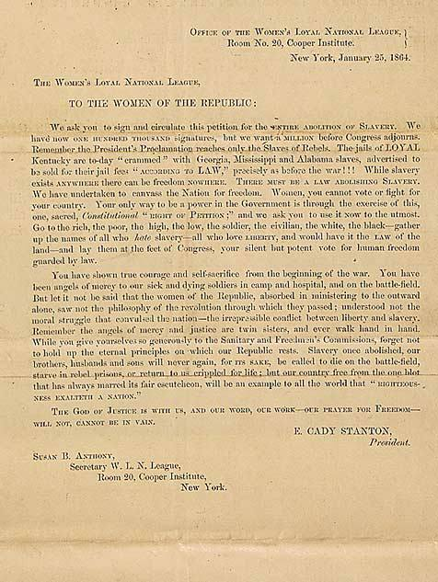
The Civil War and Emancipation
“Moral suasion”, political power and violence
Women’s Loyal National League
The League petitions for full emancipation
[Appeal is signed: THE GOD OF JUSTICE IS WITH US, AND OUR WORD, OUR WORK — OUR PRAYER FOR FREEDOM WILL NOT, CANNOT BE IN VAIN.
E. CADY STANTON President. SUSAN B. ANTHONY, Secretary W.L.N. League]

Slide 9
African American Freedom and Women’s Rights
Redefining Citizenship Rights: The Fourteenth Amendment (ratified 1868):
Section 1.
All persons born or naturalized in the United States, and subject to the jurisdiction thereof, are citizens of the United States and of the State wherein they reside. No State shall make or enforce any law which shall abridge the privileges or immunities of citizens of the United States; nor shall any State deprive any person of life, liberty, or property, without due process of law; nor deny to any person within its jurisdiction the equal protection of the laws.
Section 2.
Representatives shall be apportioned among the several States according to their respective number. . . . But when the right to vote at any election. . . . is denied to any of the male inhabitants of such State, being twenty-one years of age, and citizens of the United States, or in any way abridged, except for participation in rebellion, or other crime, the basis of representation therein shall be reduced in the proportion which the number of such male citizens shall bear to the whole number of male citizens twenty-one years of age in such State.

Slide 10
African American Freedom and Women’s Rights
Expanding voting rights: The Fifteenth Amendment (ratified 1869)
Section 1.
The right of citizens of the United States to vote shall not be denied or abridged by the United States or by any State on account of race, color, or previous condition of servitude.

Slide 11
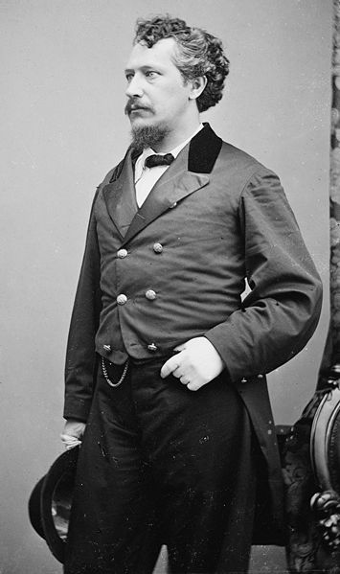
African American Freedom and Women’s Rights: The Kansas Campaign
Separate ballot measures in Kansas for African American men’s suffrage and for women’s suffrage, 1867
Stanton and Anthony campaign for women’s suffrage along with racist George Francis Train
Train: “Woman first and Negro last is my program.”
William Lloyd Garrison calls Train “a crack-brained…semi-lunatic.”
If time permits, I’ll show another segment of Not for Ourselves Alone, about the controversies over the Fourteenth and Fifteenth Amendments

Slide 12
Campaigning for Women’s Suffrage
From Equal Rights to Women’s Suffrage
Debates over the 14th and 15th Amendments divide the movement for women’s right to vote.
Stanton and Anthony head the National Woman Suffrage Association but there’s a rival American Woman Suffrage Association until they finally merge into the National American Woman Suffrage Movement (NAWSA) in 1890
Campaign for a national Constitutional amendment or emphasize state-by-state efforts?
Women win right to vote in Wyoming territory, 1869 and in Colorado, Utah and Idaho in the 1890s.

Slide 13
Two Justifications for Women’s Suffrage
The argument based on rights:
Cady Stanton pamphlet, “Suffrage a Natural Right”
Appeal to the Revolutionary era: Stanton wants votes “for the daughters of the revolutionary heroes of 1776”
“In demanding the political rights of women, we simply assert the fundamental principle of democracy--that taxation and representation should go together.”

Slide 14
Stanton, Anthony and their other bff, George

Slide 15
The Argument based on Expediency
The activists who came into the women’s movement in the late 1800s and early 1900s paid less attention to “natural rights” claims for women’s voting. They based their case on the results of women’s suffrage.
Carrie Chapman Catt says she doesn’t know if voting is a right, a duty or a privilege, but “whatever it is, women want it.”
Alice Stone Blackwell: “There are two reasons why clergymen should support the woman’s suffrage movement. First, because it is just and right and in accordance with the Golden rule, and second, because it would augment the power of the churches...against the liquor traffic, the white slave traffic, child labor, impure food, and many other existing evils.”
Why was there this shift from rights to results?

Slide 16
Women’s Suffrage, Class, Ethnicity and Race
The move for “educated suffrage”
Stanton, 1869 speech: “If American women find it hard to bear the oppressions of their own Saxon fathers, the best orders of manhood, what may they not be called to endure when all the lower orders of foreigners now crowding our shores legislate for them and their daughters. Think of Patrick and Sambo and Hans and Yung Tung. . ., who can not read the Declaration of Independence or Webster's spelling-book, making laws for Lucretia Mott [and other leading women’s rights advocates].”
The South and Suffrage:
Accepting African American disenfranchisement
Mississippi women’s suffrage leader: “The South will look to its Anglo-Saxon women as the medium through which to retain the supremacy of the white race over the African. . . .”

Slide 17
Principle, Expediency and Success
From a women’s rights movement to a women’s movement?
A new generation of women’s suffrage advocates and new styles of organizing
Women’s suffrage and Progressive Era (early 20th century) reform
World War I and postwar victory
19th Amendment Ratified August 26, 1920

Slide 18
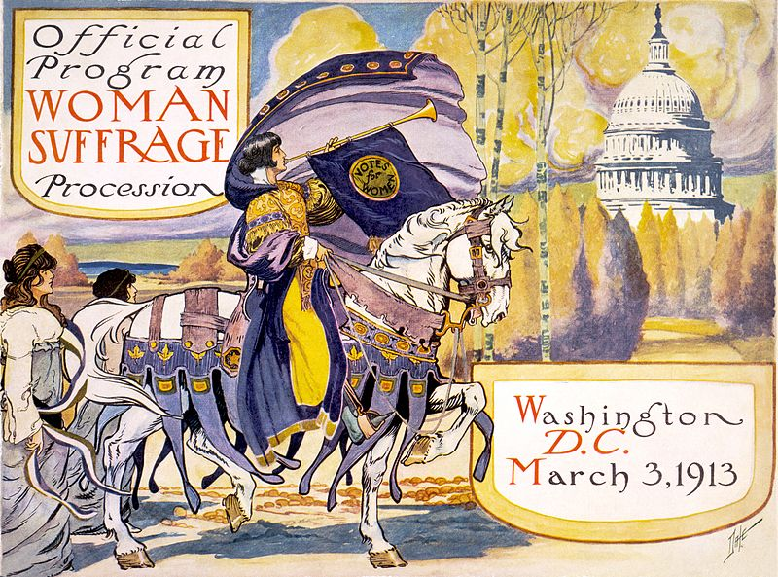
From Persuasion to Pressure

Slide 19
Anti-suffrage Cartoon

Slide 20
Success…and Failure?
After Women’s Suffrage, What Next?
A short history of the Equal Rights Amendment
Equality of rights under the law shall not be denied or abridged by the United States or by any State on account of sex.
Proposed 1923, passed by Congress in 1972, fails ratification (of 38 state legislatures needed to ratify, 35 had approved) in 1982
From Women’s Rights to Feminism
A Second Wave and a Third Wave…

Slide 21
Women’s Suffrage and Consumerism

Slide 22
“A leader of thought rather than of numbers”
The radicalism of Cady Stanton
Cady Stanton seeks to end the “fourfold bondage of church, state, capital and society.”

Slide 23
“The radical reform must start in our homes, in our nurseries, in ourselves.”
Divorce reform
Violence against women
Attacking the sexual “double standard”

Slide 24
Equality and Difference
Cady Stanton calls the idea of fundamental differences between men and women a “delusion”.
“There is no such thing as a sphere for sex.”
An “Amphiarchate” rather than an “aristocracy of sex”
But she also says, “As mothers of the race, there is a spiritual insight, a divine creative power that belongs to woman.”

Slide 25
Cady Stanton and the Solitude of Self
“Nothing adds such dignity to character as the recognition of one’s self-sovereignty.”
“The point I wish plainly to bring before you on this occasion is the individuality of each human soul--our Protestant idea, the right of individual conscience and judgment--our republican idea, individual citizenship.”
Feminist community and feminist individualism

Slide 26
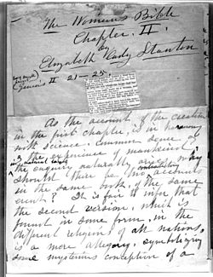
Religion and the Woman’s Bible
Cady Stanton as agnostic
“Bible historians claim special inspiration for the Old and New Testaments containing most contradictory records of the same events, of miracles opposed to all known laws, of customs that degrade the female sex of all human and animal life…and call all this ‘The Word of God.’”
Prays to “Mother and Father God”
“So perverted is the religious element in [woman's] nature, that with faith and works she is the chief support of the church and clergy; the very powers that make her emancipation impossible.”
“I know of no other books that so fully teach the subjection and degradation of woman.”

Slide 27
The Woman’s Bible and The Women’s Suffrage Movement
Susan B. Anthony opposes Stanton’s Bible project: “Of all her great speeches, I am always proud—but of her Bible commentaries, I am not proud—either of their spirit or letter ... But I shall love and honor her to the end.”
Woman’s Bible denounced at the 1896 National American Woman Suffrage Association convention: “As an organization we have been held responsible for the action of an individual ... in issuing a volume with a pretentious title, covering a jumble of comment ... without either scholarship or literary value, set forth in a spirit which is neither reverent nor inquiring.”
Convention disassociates itself from the Woman’s Bible
Stanton blames controversy on clergy: "Our politicians are calm and complacent under our fire but the clergy jump round the moment you aim a pop gun at them 'like parched peas on a hot skillet'"

