Slide 1
Elizabeth Cady Stanton: Women’s Rights and Freedmen’s Rights
History 350
May 14, 2015

Slide 2
Announcements
The third discussion forum question (on Cady Stanton and the women’s rights movement) is now available on Blackboard. The deadline for posts is 11:59 p.m. May 28.
Study questions on Vivian Gornick, The Solitude of Self, are now online here.
The paper is due by class time on May 26 NEW! May 28. The topic options and instructions are available on Blackboard. Today I’ll spend a few minutes in class talking about approaches to doing the paper and the different topics.

Slide 3
Notes on Midterm
Summarizing what I said in class on Tuesday:
  Average grade on essay was about B, slightly lower on IDs.
  We recorded essay and ID grades separately. Essay is worth two-thirds of the exam.
  Most people chose Essay 1 (on Paine) or 2 (Turner as madman).
  IDs were worth a maximum of two points each, partial credit given. We added up your scores and translated the number to a letter grade as follows:
  8.5-10=A 6.5-8=B 4.5-6=C 2.5-4=D 0-2=F

Slide 4
Some Websites of Interest
Seneca Falls National Historical Park site on the origins of the women’s rights movement
Brief biographical sketch of Elizabeth Cady Stanton from National Women’s Hall of Fame
Not for Ourselves Alone—PBS/Ken Burns documentary on Stanton and Susan B. Anthony
Website for the edition of the Stanton-Anthony papers
The Grimke Sisters and Theodore Dwight Weld debate women’s role in the abolition movement
Anthony got arrested for trying to vote in 1873. This site deals with her trial
Stanton, Anthony and Matilda Joslyn Gage wrote an enormous History of Women Suffrage in 1881. Here’s their account of the Seneca Falls conference.

Slide 5
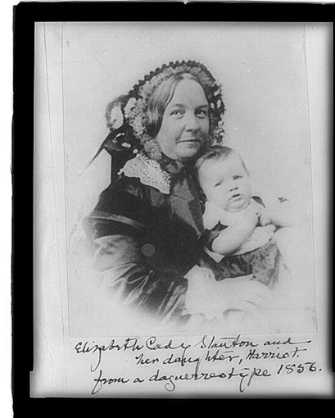
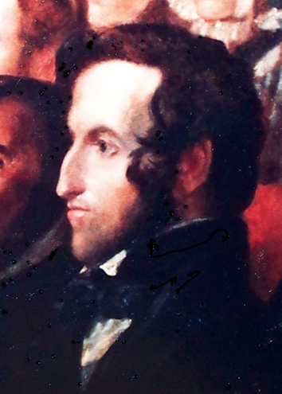
Becoming Mrs. Henry B. Stanton
"We lived together without more than the normal matrimonial friction for more than half a century.“
  Elizabeth Cady Stanton in her autobiography
  Sarah Grimke: “Henry greatly needs a humble, holy companion, and she needs the same.”
London Honeymoon
Building a family
Henry Brewster
Stanton 1840

Slide 6
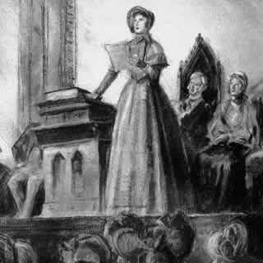
The Origins of the Women’s Rights Movement
Seneca Falls: Domesticity and Activism
The Declaration of Sentiments
Preamble: We hold these truths to be self-evident: that all men and women are created equal; that they are endowed by their Creator with certain inalienable rights;
The Convention and the Demand for Suffrage: “Now, in view of this entire disfranchisement of one-half the people … and because women do feel themselves aggrieved, oppressed, and fraudulently deprived of their most sacred rights, we insist that they have immediate admission to all the rights and privileges which belong to them as citizens of the United States.”
We’ll watch a few minutes of Not For Ourselves Alone, documentary about the Seneca Falls convention.
Seneca Falls Women’s Rights Convention July 19-20, 1848

Slide 7
Seneca Falls Declaration and Resolutions
Women’s Roles and Women’s Rights
What did women want?
Which women?
How to gain equality?
  State Women’s Rights Conventions
  The difficulties of organizing
“In entering upon the great work before us, we anticipate no small amount of misconception, misrepresentation, and ridicule; but we shall use every instrumentality within our power to effect our object. We shall employ agents, circulate tracts, petition the State and National legislatures, and endeavor to enlist the pulpit and the press in our behalf. We hope this Convention will be followed by a series of Conventions embracing every part of the country.”
  Why “ridicule”?

Slide 8
The Scope of the Nineteenth Century Women’s Movement
Seneca Falls: Beyond suffrage in the Declaration of Sentiments
Having deprived her of this first right of a citizen, the elective franchise, thereby leaving her without representation in the halls of legislation, he has oppressed her on all sides.
He has made her, if married, in the eye of the law, civilly dead.
He has taken from her all right in property, even to the wages she earns. * * *
He has so framed the laws of divorce, as to what shall be the proper causes of divorce; in case of separation, to whom the guardianship of the children shall be given; as to be wholly regardless of the happiness of women—the law, in all cases, going upon the false supposition of the supremacy of man, and giving all power into his hands.
After depriving her of all rights as a married woman, if single and the owner of property, he has taxed her to support a government which recognizes her only when her property can be made profitable to it.

Slide 9
Seneca Falls: Other Issues (continued)
He has monopolized nearly all the profitable employments, and from those she is permitted to follow, she receives but a scanty remuneration.
He closes against her all the avenues to wealth and distinction, which he considers most honorable to himself. As a teacher of theology, medicine, or law, she is not known.
He has denied her the facilities for obtaining a thorough education—all colleges being closed against her.
He allows her in Church as well as State, but a subordinate position, claiming Apostolic authority for her exclusion from the ministry, and, with some exceptions, from any public participation in the affairs of the Church.
He has created a false public sentiment, by giving to the world a different code of morals for men and women, by which moral delinquencies which exclude women from society, are not only tolerated but deemed of little account in man.
He has usurped the prerogative of Jehovah himself, claiming it as his right to assign for her a sphere of action, when that belongs to her conscience and her God.
He has endeavored, in every way that he could to destroy her confidence in her own powers, to lessen her self-respect, and to make her willing to lead a dependent and abject life.

Slide 10
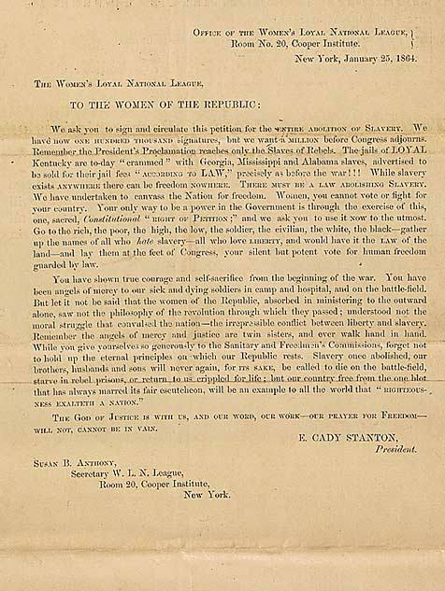
The Civil War and Emancipation
“Moral suasion”, political power and violence
Women’s Loyal National League
The League petitions for full emancipation
[Appeal is signed: THE GOD OF JUSTICE IS WITH US, AND OUR WORD, OUR WORK — OUR PRAYER FOR FREEDOM WILL NOT, CANNOT BE IN VAIN.
E. CADY STANTON
President.
SUSAN B. ANTHONY,
Secretary W.L.N. League]

Slide 11
African American Freedom and Women’s Rights
Redefining Citizenship Rights: The Fourteenth Amendment (ratified 1868):
Section 1.
All persons born or naturalized in the United States, and subject to the jurisdiction thereof, are citizens of the United States and of the State wherein they reside. No State shall make or enforce any law which shall abridge the privileges or immunities of citizens of the United States; nor shall any State deprive any person of life, liberty, or property, without due process of law; nor deny to any person within its jurisdiction the equal protection of the laws.
Section 2.
Representatives shall be apportioned among the several States according to their respective number. . . . But when the right to vote at any election. . . . is denied to any of the male inhabitants of such State, being twenty-one years of age, and citizens of the United States, or in any way abridged, except for participation in rebellion, or other crime, the basis of representation therein shall be reduced in the proportion which the number of such male citizens shall bear to the whole number of male citizens twenty-one years of age in such State.

Slide 12
African American Freedom and Women’s Rights
Expanding voting rights: The Fifteenth Amendment (ratified 1869)
Section 1.
The right of citizens of the United States to vote shall not be denied or abridged by the United States or by any State on account of race, color, or previous condition of servitude.

Slide 13
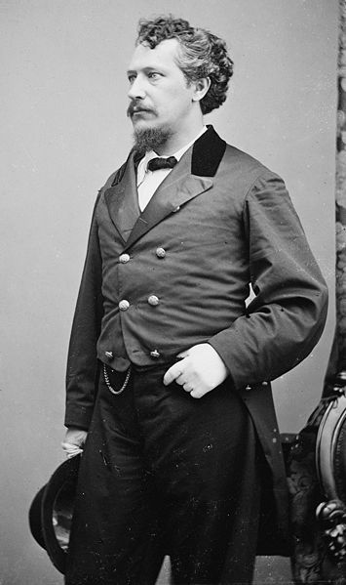
African American Freedom and Women’s Rights: The Kansas Campaign
Separate ballot measures in Kansas for African American men’s suffrage and for women’s suffrage, 1867
Stanton and Anthony campaign for women’s suffrage along with racist George Francis Train
  Train: “Woman first and Negro last is my program.”
  William Lloyd Garrison calls Train “a crack-brained…semi-lunatic.”
If time permits, I’ll show another segment of Not for Ourselves Alone, about the controversies over the Fourteenth and Fifteenth Amendments

Slide 14
Campaigning for Women’s Suffrage
From Equal Rights to Women’s Suffrage
Debates over the 14th and 15th Amendments divide the movement for women’s right to vote.
  Stanton and Anthony head the National Woman Suffrage Association but there’s a rival American Woman Suffrage Association until they finally merge into the National American Woman Suffrage Movement (NAWSA) in 1890
Campaign for a national Constitutional amendment or emphasize state-by-state efforts?
Women win right to vote in Wyoming territory, 1869 and in Colorado, Utah and Idaho in the 1890s.

Slide 15
Two Justifications for Women’s Suffrage
The argument based on rights:
  Cady Stanton pamphlet, “Suffrage a Natural Right”
  Appeal to the Revolutionary era: Stanton wants votes “for the daughters of the revolutionary heroes of 1776”
  “In demanding the political rights of women, we simply assert the fundamental principle of democracy--that taxation and representation should go together.”

Slide 16
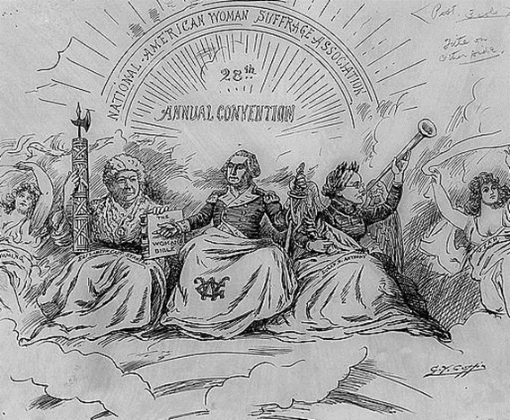
Stanton, Anthony and their other bff, George

Slide 17
The Argument based on Expediency
The activists who came into the women’s movement in the late 1800s and early 1900s paid less attention to “natural rights” claims for women’s voting. They based their case on the results of women’s suffrage.
  Carrie Chapman Catt says she doesn’t know if voting is a right, a duty or a privilege, but “whatever it is, women want it.”
  Alice Stone Blackwell: “There are two reasons why clergymen should support the woman’s suffrage movement. First, because it is just and right and in accordance with the Golden rule, and second, because it would augment the power of the churches...against the liquor traffic, the white slave traffic, child labor, impure food, and many other existing evils.”
Why was there this shift from rights to results?

Slide 18
Women’s Suffrage, Class, Ethnicity and Race
The move for “educated suffrage”
Stanton, 1869 speech: “If American women find it hard to bear the oppressions of their own Saxon fathers, the best orders of manhood, what may they not be called to endure when all the lower orders of foreigners now crowding our shores legislate for them and their daughters. Think of Patrick and Sambo and Hans and Yung Tung. . ., who can not read the Declaration of Independence or Webster's spelling-book, making laws for Lucretia Mott [and other leading women’s rights advocates].”
The South and Suffrage:
  Accepting African American disenfranchisement
  Mississippi women’s suffrage leader: “The South will look to its Anglo-Saxon women as the medium through which to retain the supremacy of the white race over the African. . . .”

Slide 19
Principle, Expediency and Success
From a women’s rights movement to a women’s movement?
A new generation of women’s suffrage advocates and new styles of organizing
Women’s suffrage and Progressive Era (early 20th century) reform
World War I and postwar victory
19th Amendment Ratified August 26, 1920

Slide 20
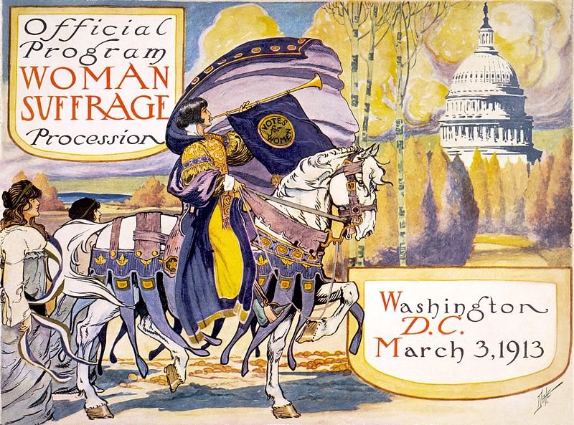
From Persuasion to Pressure

Slide 21
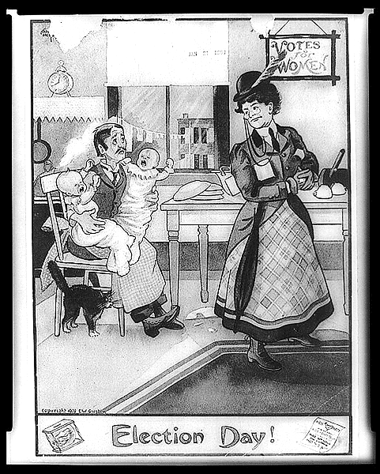
Anti-suffrage Cartoon

Slide 22
Success…and Failure?
After Women’s Suffrage, What Next?
A short history of the Equal Rights Amendment
  Equality of rights under the law shall not be denied or abridged by the United States or by any State on account of sex.
  Proposed 1923, passed by Congress in 1972, fails ratification (of 38 state legislatures needed to ratify, 35 had approved) in 1982
From Women’s Rights to Feminism
A Second Wave and a Third Wave…

Slide 23
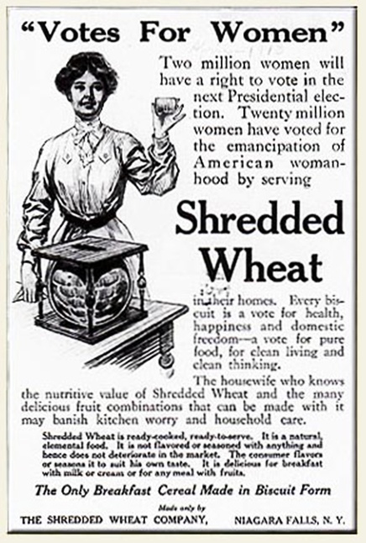
Women’s Suffrage and Consumerism

