Slide 1
Elizabeth Cady Stanton: Women’s Rights and Women’s Suffrage
History 350
May 12, 2015

Slide 2
Announcements
We’ll return midterms at the end of class today. I’ll have a few general remarks on them—mostly positive!
The second discussion forum closes tonight at 11:59 pm.
The third discussion forum question (on Cady Stanton and the women’s rights movement) is now available on Blackboard. The deadline for posts is 11:59 p.m. May 28.
Study questions on Vivian Gornick, The Solitude of Self, are now online here.
The paper is due by class time on May 26. The topic options and instructions are available on Blackboard. On Thursday (May 14), I’ll spend a few minutes in class talking about approaches to doing the paper and the different topics.

Slide 3
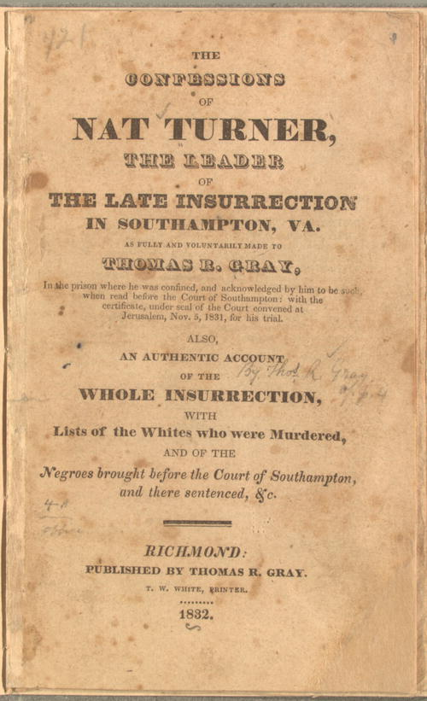
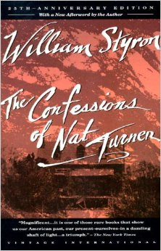
“Confessions” vs. Confessions
For those considering Option #3 (“History and Fiction—Nat Turner”) for your paper, I want to clarify: The “Confessions of Nat Turner” recorded by Thomas Gray in Turner’s jail cell in 1831 is not what you need to read for this paper topic. (You should have read that for the midterm.) For the paper, you need to read William Styron’s 1967 novel (a work of fiction) which has the same title: The Confessions of Nat Turner.
NO YES

Slide 4
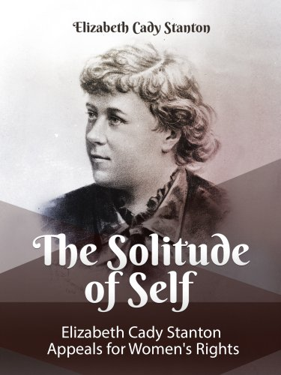
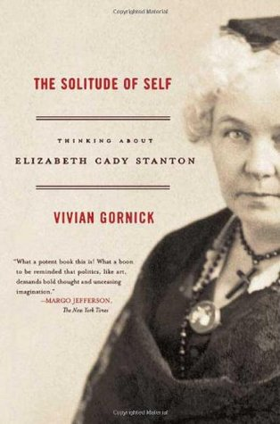
“Solitude” vs. Solitude
Remember that for the section of the course on Elizabeth Cady Stanton and the nineteenth century women’s movement, you’re expected to read two different things entitled “The Solitude of Self.” One is a speech she gave in the 1890s. You can link to it from the syllabus or below. The other is a recent book by the modern feminist Vivian Gornick. You’ll have to buy or otherwise acquire access to the Gornick book.
Read both of these. Link to the Stanton speech here.

Slide 5
Some Websites of Interest
Seneca Falls National Historical Park site on the origins of the women’s rights movement
Brief biographical sketch of Elizabeth Cady Stanton from National Women’s Hall of Fame
Not for Ourselves Alone—PBS/Ken Burns documentary on Stanton and Susan B. Anthony
Website for the edition of the Stanton-Anthony papers
The Grimke Sisters and Theodore Dwight Weld debate women’s role in the abolition movement
Anthony got arrested for trying to vote in 1873. This site deals with her trial
Stanton, Anthony and Matilda Joslyn Gage wrote an enormous History of Women Suffrage in 1881. Here’s their account of the Seneca Falls conference.

Slide 6
Some Issues to Consider
In our sessions on Elizabeth Cady Stanton and the 19th Century Women’s Rights Movement, there are four broad issues I want to emphasize. These are topics that repeatedly occur in studying radical (and non-radical) social movements:
1. What’s the relationship between personal life and public political activity?
2. How broad or focused should a social movement be?
3. When is compromise effective? When is it moral?
4. Is religion a liberator or an oppressor?

Slide 7
“Separate Spheres” for Men and Women?
“In no country has such constant care been taken as in America to trace two clearly distinct lines of action for the two sexes and to make them keep pace one with the other, but in two pathways that are always different. American women never manage the outward concerns of the family or conduct a business or take a part in political life; nor are they, on the other hand, ever compelled to perform the rough labor of the fields or to make any of those laborious efforts which demand the exertion of physical strength. No families are so poor as to form an exception to this rule. If, on the one hand, an American woman cannot escape from the quiet circle of domestic employments, she is never forced, on the other, to go beyond it.”--Alexis de Tocqueville more from Tocqueville about American women
Was Tocqueville correct?

Slide 8
Women’s “Nature”
“The Cult of True Womanhood” (the title of an influential article published in 1966 by historian Barbara Welter) described a set of nineteenth-century assumptions about women’s inherent nature.
Piety
Purity
Domesticity
Submissiveness
Which women might this apply to?
Did women’s lives actually fit these prescriptions for them?

Slide 9
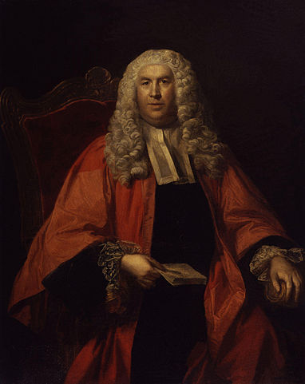
Women’s Legal Status: Couverture
In the late 1700s, the English legal scholar William Blackstone described married women’s legal status:
“By marriage, the husband and wife are one person in law: that is, the very being or legal existence of the woman is suspended during the marriage, or at least is incorporated and consolidated into that of the husband: under whose wing, protection, and cover, she performs every thing….”

Slide 10
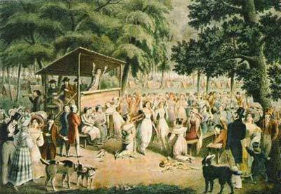
Sources of the Women’s Rights Movement: Religious Revivalism
The Second Great Awakening 1820s-30s
Conscience and Salvation
“Be ye therefore perfect, even as your Father which is in heaven is perfect.”
Male ministers, female congregations
At right: Open-air revival
Meeting.

Slide 11
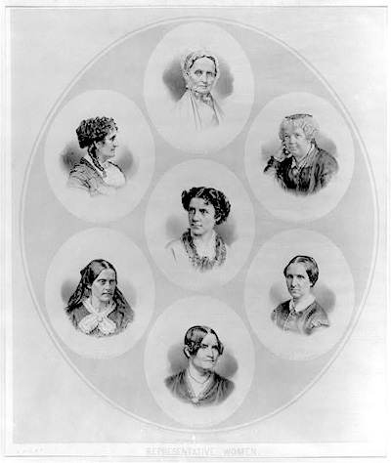
Sources of the Women’s Rights Movement (continued)
Temperance
Antislavery
At right: Notable women in the abolitionist and women’s rights movements of the 19th century. Lucretia Mott, Grace Greenwood, Elizabeth Cady Stanton, Anna Dickinson, Mary Livermore, Susan B. Anthony, and Lydia Maria Child.

Slide 12
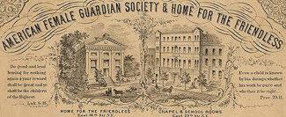
Sources of the Women’s Rights Movement: Moral Reform
Anti-prostitution movement
Middle-class women in public roles
Criticizing male behavior
Women’s solidarity across class and cultural divides

Slide 13
Sources of the Women’s Rights Movement: Solidarity and Sisterhood
Susan B. Anthony—Elizabeth Cady Stanton’s bff
Women’s Friendships and Social Activism
“Boston Marriages”
The L-Word: Does it matter?

Slide 14
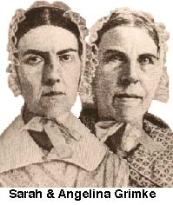
Women and Abolitionism
Women’s Role and Women’s Rights
Sarah and Angelina Grimke
The Grimke Sisters: Wealthy and Powerful South Carolina Slaveholding Family
Conversion and Commitment to Anti-Slavery
Controversy over Angelina Grimke as anti-slavery lecturer: “The time to assert a right is the time when that right is denied.”
1840: American Anti-Slavery Society divides over women’s roles

Slide 15
Elizabeth Cady Stanton 1815-1902
Becoming Elizabeth Cady
Cady Family Home, Jamestown, New York
Privilege and Limitations
Education for what?
An environment of conservatism and stirrings of reform

Slide 16
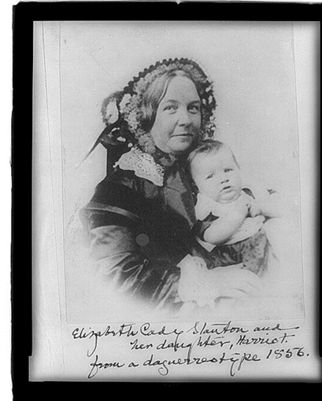
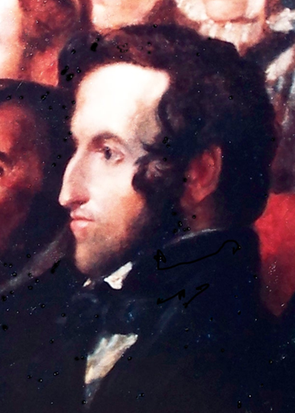
Becoming Mrs. Henry B. Stanton
"We lived together without more than the normal matrimonial friction for more than half a century.“
Elizabeth Cady Stanton in her autobiography
Sarah Grimke: “Henry greatly needs a humble, holy companion, and she needs the same.”
London Honeymoon
Building a family
Henry Brewster
Stanton 1840

Slide 17
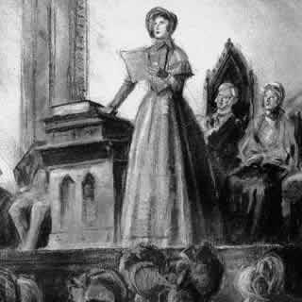
The Origins of the Women’s Rights Movement
Seneca Falls: Domesticity and Activism
The Declaration of Sentiments
Preamble: We hold these truths to be self-evident: that all men and women are created equal; that they are endowed by their Creator with certain inalienable rights;
The Convention and the Demand for Suffrage: “Now, in view of this entire disfranchisement of one-half the people … and because women do feel themselves aggrieved, oppressed, and fraudulently deprived of their most sacred rights, we insist that they have immediate admission to all the rights and privileges which belong to them as citizens of the United States.”
Seneca Falls Women’s Rights Convention July 19-20, 1848

Slide 18
Seneca Falls Declaration and Resolutions
Women’s Roles and Women’s Rights
What did women want?
Which women?
How to gain equality?
State Women’s Rights Conventions
The difficulties of organizing
“In entering upon the great work before us, we anticipate no small amount of misconception, misrepresentation, and ridicule; but we shall use every instrumentality within our power to effect our object. We shall employ agents, circulate tracts, petition the State and National legislatures, and endeavor to enlist the pulpit and the press in our behalf. We hope this Convention will be followed by a series of Conventions embracing every part of the country.”
Why “ridicule”?

Slide 19
The Scope of the Nineteenth Century Women’s Movement
Seneca Falls: Beyond suffrage in the Declaration of Sentiments
Having deprived her of this first right of a citizen, the elective franchise, thereby leaving her without representation in the halls of legislation, he has oppressed her on all sides.
He has made her, if married, in the eye of the law, civilly dead.
He has taken from her all right in property, even to the wages she earns. * * *
He has so framed the laws of divorce, as to what shall be the proper causes of divorce; in case of separation, to whom the guardianship of the children shall be given; as to be wholly regardless of the happiness of women—the law, in all cases, going upon the false supposition of the supremacy of man, and giving all power into his hands.
After depriving her of all rights as a married woman, if single and the owner of property, he has taxed her to support a government which recognizes her only when her property can be made profitable to it.

Slide 20
Seneca Falls: Other Issues (continued)
He has monopolized nearly all the profitable employments, and from those she is permitted to follow, she receives but a scanty remuneration.
He closes against her all the avenues to wealth and distinction, which he considers most honorable to himself. As a teacher of theology, medicine, or law, she is not known.
He has denied her the facilities for obtaining a thorough education—all colleges being closed against her.
He allows her in Church as well as State, but a subordinate position, claiming Apostolic authority for her exclusion from the ministry, and, with some exceptions, from any public participation in the affairs of the Church.
He has created a false public sentiment, by giving to the world a different code of morals for men and women, by which moral delinquencies which exclude women from society, are not only tolerated but deemed of little account in man.
He has usurped the prerogative of Jehovah himself, claiming it as his right to assign for her a sphere of action, when that belongs to her conscience and her God.
He has endeavored, in every way that he could to destroy her confidence in her own powers, to lessen her self-respect, and to make her willing to lead a dependent and abject life.

Slide 21
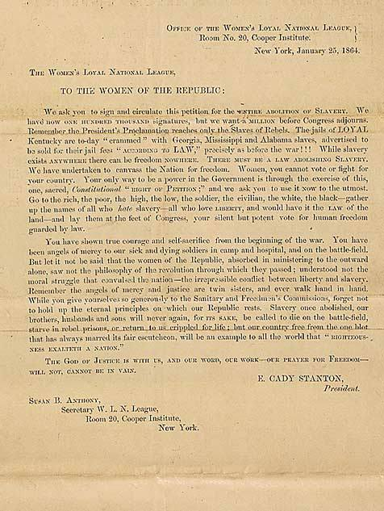
The Civil War and Emancipation
“Moral suasion”, political power and violence
Women’s Loyal National League
The League petitions for full emancipation
[Appeal is signed: THE GOD OF JUSTICE IS WITH US, AND OUR WORD, OUR WORK — OUR PRAYER FOR FREEDOM WILL NOT, CANNOT BE IN VAIN.
E. CADY STANTON President. SUSAN B. ANTHONY, Secretary W.L.N. League]

Slide 22
African American Freedom and Women’s Rights
Redefining Citizenship Rights: The Fourteenth Amendment (ratified 1868):
Section 1.
All persons born or naturalized in the United States, and subject to the jurisdiction thereof, are citizens of the United States and of the State wherein they reside. No State shall make or enforce any law which shall abridge the privileges or immunities of citizens of the United States; nor shall any State deprive any person of life, liberty, or property, without due process of law; nor deny to any person within its jurisdiction the equal protection of the laws.
Section 2.
Representatives shall be apportioned among the several States according to their respective number. . . . But when the right to vote at any election. . . . is denied to any of the male inhabitants of such State, being twenty-one years of age, and citizens of the United States, or in any way abridged, except for participation in rebellion, or other crime, the basis of representation therein shall be reduced in the proportion which the number of such male citizens shall bear to the whole number of male citizens twenty-one years of age in such State.

Slide 23
African American Freedom and Women’s Rights
Expanding voting rights: The Fifteenth Amendment (ratified 1869)
Section 1.
The right of citizens of the United States to vote shall not be denied or abridged by the United States or by any State on account of race, color, or previous condition of servitude.

Slide 24
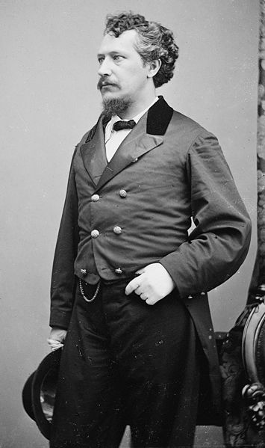
African American Freedom and Women’s Rights: The Kansas Campaign
Separate ballot measures in Kansas for African American men’s suffrage and for women’s suffrage, 1867
Stanton and Anthony campaign for women’s suffrage along with racist George Francis Train
Train: “Woman first and Negro last is my program.”
William Lloyd Garrison calls Train “a crack-brained…semi-lunatic.”

Slide 25
Campaigning for Women’s Suffrage
From Equal Rights to Women’s Suffrage
Debates over the 14th and 15th Amendments divide the movement for women’s right to vote.
Stanton and Anthony head the National Woman Suffrage Association but there’s a rival American Woman Suffrage Association until they finally merge into the National American Woman Suffrage Movement (NAWSA) in 1890
Campaign for a national Constitutional amendment or emphasize state-by-state efforts?
Women win right to vote in Wyoming territory, 1869 and in Colorado, Utah and Idaho in the 1890s.

Slide 26
Two Justifications for Women’s Suffrage
The argument based on rights:
Cady Stanton pamphlet, “Suffrage a Natural Right”
Appeal to the Revolutionary era: Stanton wants votes “for the daughters of the revolutionary heroes of 1776”
“In demanding the political rights of women, we simply assert the fundamental principle of democracy--that taxation and representation should go together.”

Slide 27
Stanton, Anthony and their other bff, George

Slide 28
The Argument based on Expediency
The activists who came into the women’s movement in the late 1800s and early 1900s paid less attention to “natural rights” claims for women’s voting. They based their case on the results of women’s suffrage.
Carrie Chapman Catt says she doesn’t know if voting is a right, a duty or a privilege, but “whatever it is, women want it.”
Alice Stone Blackwell: “There are two reasons why clergymen should support the woman’s suffrage movement. First, because it is just and right and in accordance with the Golden rule, and second, because it would augment the power of the churches...against the liquor traffic, the white slave traffic, child labor, impure food, and many other existing evils.”
Why was there this shift from rights to results?

Slide 29
Women’s Suffrage, Class, Ethnicity and Race
The move for “educated suffrage”
Stanton, 1869 speech: “If American women find it hard to bear the oppressions of their own Saxon fathers, the best orders of manhood, what may they not be called to endure when all the lower orders of foreigners now crowding our shores legislate for them and their daughters. Think of Patrick and Sambo and Hans and Yung Tung. . ., who can not read the Declaration of Independence or Webster's spelling-book, making laws for Lucretia Mott [and other leading women’s rights advocates].”
The South and Suffrage:
Accepting African American disenfranchisement
Mississippi women’s suffrage leader: “The South will look to its Anglo-Saxon women as the medium through which to retain the supremacy of the white race over the African. . . .”

