Slide 1
Introduction: Themes and Controversies in American Radicalism
History 350
March 31, 2015

Slide 2
Some Bureaucratic Matters
History 350 is the first term of two on the history of American Radicalism. It deals with the period from the American Revolution through the late 1800s. Hist 351, twentieth-century and beyond, will be offered in summer session and fall quarter.
The syllabus for the course is the primary entry point for course information: outlines and PowerPoints for class sessions, assignments, etc. You’ll find it in the Course Documents section of the Hist 350 Blackboard site.

Slide 3
Syllabus Overview
Before each class session, I’ll post a Powerpoint or outline for the class and link to it from the syllabus. The Powerpoints and outlines are meant as frameworks, not substitutes, for your own note taking, class attendance and studying for exams.
Information about requirements, assignments and books is on the syllabus. I’ll run through it briefly.
Regular attendance is important. I don’t check attendance, but the course should mean a lot more to you if you take part in class discussion. In marginal cases, positive contributions in class will earn you a higher grade.

Slide 4
Definitions: Theirs, Yours, Mine
Merriam-Webster online dictionary offers three definitions:
very new and different from what is traditional or ordinary
very basic and important
having extreme political or social views that are not shared by most people
Can we do better?

Slide 5
Themes and Questions about the Course
Defining Radicalism
Equality as core value
“Illegitimate Means”
Complicating the definition
What kind of equality?
What’s legitimate?
Political and cultural change
Do “left” and “right” make sense as categories?

Slide 6
Themes and Questions about the Course
What’s the meaning of the American Revolution?
Is American history marked by consensus or conflict?
What role has violence played in social change?
How have issues of race and racism shaped the history of American radicalism?
What determines the success or failure of social movements?
What motivates individuals to get involved in radical movements for social change?

Slide 7
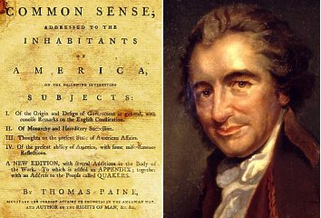
Tom Paine

Slide 8
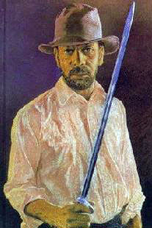
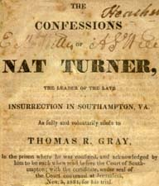
Nat Turner

Slide 9
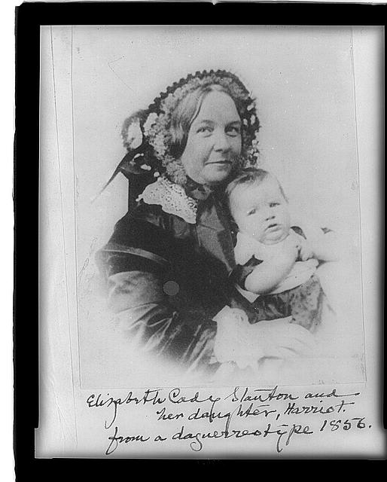
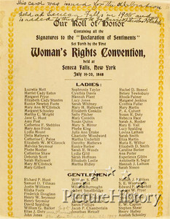
Elizabeth Cady Stanton

Slide 10
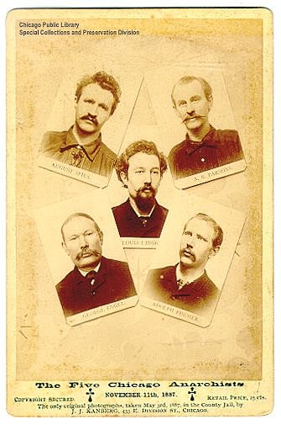
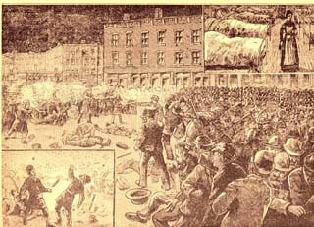
Haymarket

Slide 11
Whose Revolution?
A “World Turned Upside-Down”? A social revolution?
“The World Turned Upside-Down” was a British song from the 1600s, allegedly played as the British troops surrendered at the final battle of the Revolution at Yorktown, Virginia in 1781. Here’s a YouTube version.
A democratic revolution?
A revolution for liberty?
A “conservative colonial rebellion”?

Slide 12
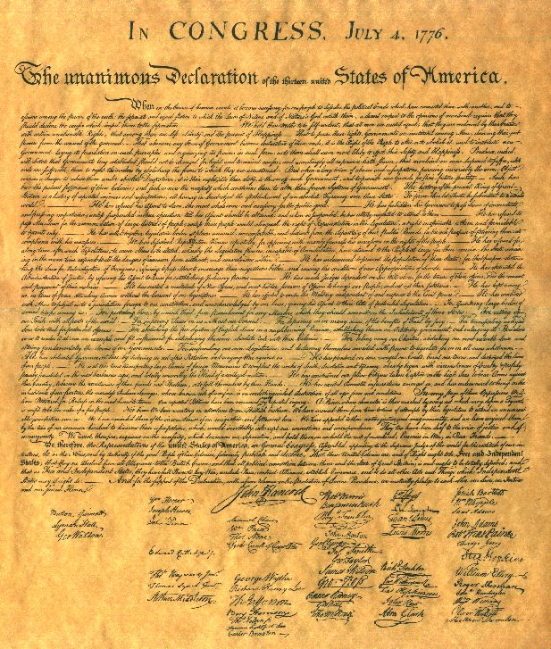
Whose Declaration?
“We hold these truths to be self-evident, that all men are created equal, that they are endowed by their Creator with certain unalienable Rights, that among these are Life, Liberty and the pursuit of Happiness.”
“The history of the present King of Great Britain is a history of repeated injuries and usurpations, all having in direct object the establishment of an absolute Tyranny over these States. To prove this, let Facts be submitted to a candid world.”
Transcript of the Declaration

