Slide 1
1. Remembering Haymarket 2. A Peep into the Twentieth Century 3. Final Exam Review
History 350
June 4, 2015

Slide 2
Announcements
We will return graded papers after class today. We’ll have all papers that were submitted on time last Thursday. We’ll have all papers, including late ones, graded and available at the final exam.
The final exam is scheduled for Monday, June 8 at 12:30. Instructions and essay questions are now online at http://pages.uoregon.edu/dapope/350final--spring15.htm I’ll reserve some time in class today for exam review.
If you’re doing the take-home, bring hard copy to my office, 366 McKenzie by 12:15 Monday, June 8. After that, bring it to our classroom by the 12:30 start of the in-class exam.
The fourth forum question (on radical labor) is now available. The deadline for posts is 11:59 p.m. Wed., June 10. We’ll notify you before the final if you got a high pass or a no pass on the third forum.
Late papers won’t be accepted after class time today.
We seldom comment on final exams because the vast majority of students never see their tests after handing them in. We will post course grades on Blackboard but I can’t predict when we’ll be done grading.

Slide 3
Haymarket Video Clips
Note: Last Thursday, I showed three YouTube clips about Haymarket. They provide a brief overview of the bombing and its context. Although they’re much less complete than Duberman’s novel, if you missed them, you may want to watch them to complement your reading of the book. Here are the links : part 1 part 2 part 3 (about 15 min. total)

Slide 4
Some Websites of Interest
PBS American Experience documentary Chicago: City of the Century website—note the section on anarchists.
The Great Railroad Strike of 1877 video (12 min.)
Preamble and Declaration of Principles of the Knights of Labor
Excerpts from Chicago: City of the Century on Haymarket affair: part 1 part 2 part 3 (about 15 min. total)
An archive of material on Haymarket. (This is part of a massive “Anarchy Archives”— “an online research center on the history and theory of anarchism”.
An extensive site on “The Dramas of Haymarket”
“Louis Lingg and the Bombs” is a French punk band. Among their songs: “Conspiracy”, “Louis Lingg, Anarchist” and “Death in the Haymarket”. Here’s a link to some of their songs.

Slide 5
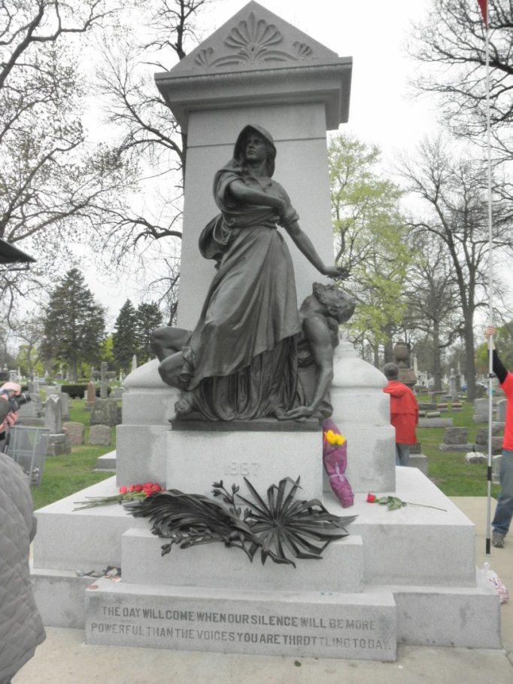
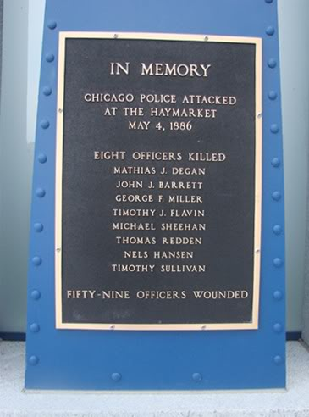
The Legacy of Haymarket
Police Monument
Martyrs’ Monument

Slide 6
Monumental Histories: The Police Monument
1889: Chicago Tribune, the city’s leading newspaper, leads fundraising campaign for a police monument
1927: Streetcar crash damages monument. Motorman says he’s "sick of seeing that policeman with his arm raised.”
1969 and 1970: Monument bombed, statue moved to Police Department Headquarters
2007 Monument rededicated near Haymarket Square

Slide 7
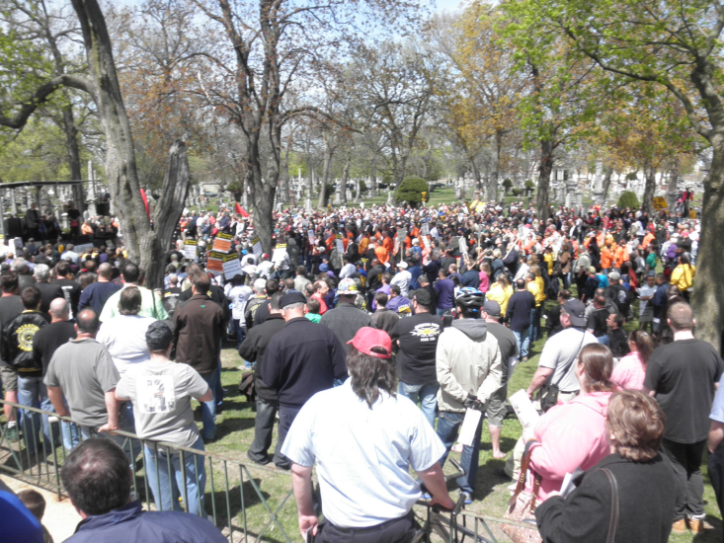
Labor Monuments
Martyrs’ Monument dedicated 1893 in Waldheim Cemetery. Rededicated 2011 on 125th anniversary of the bombing.
It’s still controversial. Note anarchist graffiti on monument plaque.

Slide 8
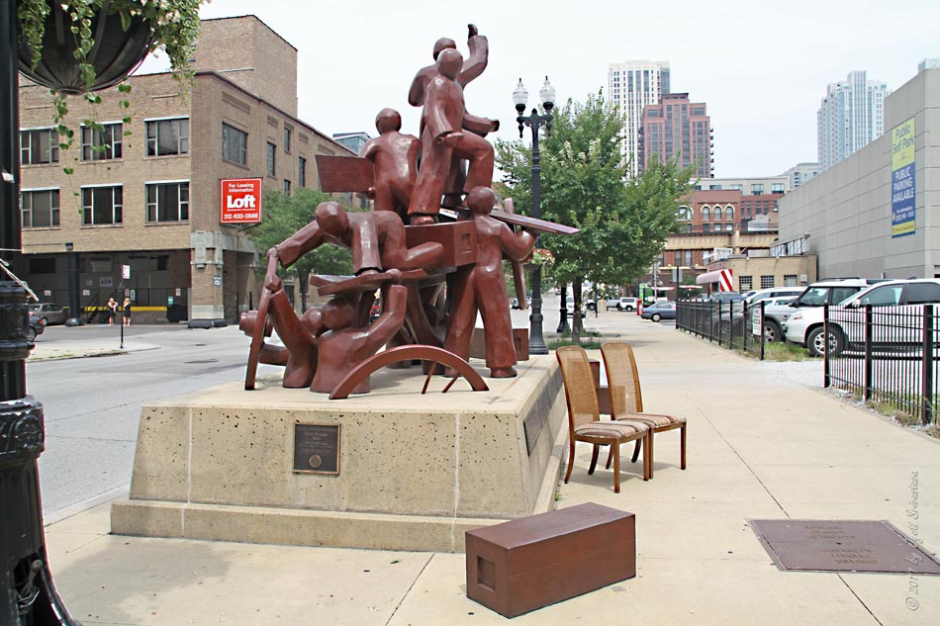
A New Memorial: Dedicated 2004
The New York Times called this “an ambiguous memorial to the Haymarket attack.”

Slide 9
Comments about the New Memorial
“I was pretty adamant in my own mind that it would not be useful to depict violence. The violence didn’t seem important, because this event was made up of much bigger ideas than one particular incident….I want to suggest the complexity of truth, but also people’s responsibility for their actions and for the effect of their actions.” –Mary Brogger, the sculptor
"I can remember that in my own lifetime, not long ago, bringing up the idea of commemorating Haymarket was impossible because it revived emotions that were too strong.”—official cultural historian of Chicago
"Haymarket represents the beginning of labor rights in this country. It's really about our most important right, which is freedom of speech, freedom to protest. If you don't have that, you're going to be oppressed.“—Head of Chicago Federation of Labor
"We've come a long way. We recognize that the people who fought for labor rights in the past gave us the protections we have today.“—Head of Chicago police union
"Those men who were hanged are being presented as social democrats or liberal reformers, when in fact they dedicated their whole lives to anarchy and social revolution. If they were here today, they'd be denouncing this project and everyone involved in it.“—anarchist protester at dedication ceremony
(From New York Times, September 15, 2004)

Slide 10
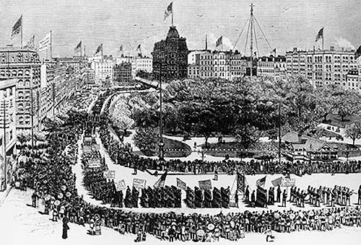
More on Haymarket 2015
There’s a movie being made about Haymarket: website here:
You can follow Albert and Lucy Parsons on Twitter!

Slide 11
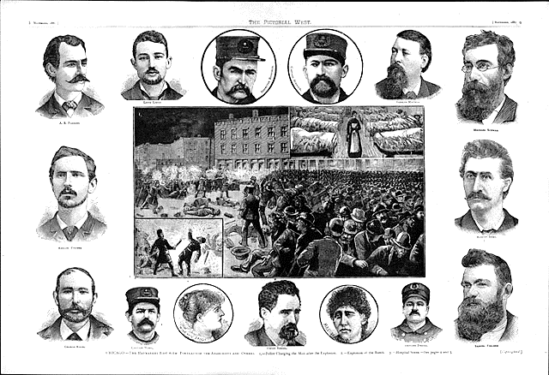
A Souvenir Photograph for You

Slide 12
Into the Twentieth Century
The meanings of equality
The limits of equality of opportunity
Is equality sameness?
Do rights make sense?
“Rights talk” as political rhetoric?
Rights and the existing power structure
Sources of radicalism in capitalist America
And in post-industrial society?

Slide 13
How to Study for the Essay Section of the Exam
Read the question. Think about what it’s asking you to do—Respond to a quotation? Analyze a document? Compare? Explain the causes of an event? . . .
Several of these questions ask you to do more than one thing. For example, all of the quotation questions make several assertions. Be sure to prepare to respond to all aspects of the quote. Other questions ask you to apply the same approach to multiple topics. Be sure you know what you’re expected to do. If a question says, “Discuss at least two…”, then two is perfectly acceptable. Doing a third simply in hopes of getting “extra credit” is a mistake.
After you’ve read the question, think about what resources—book, online reading assignments, material on Blackboard, PowerPoints and lecture notes, etc.—could help you prepare to answer the question. You’re not expected to go beyond the assigned readings. To give a specific example, Wikipedia has many virtues, but reading the Wikipedia entry on Elizabeth Cady Stanton or the Seneca Falls Convention or Albert Parsons is no substitute for doing the assigned reading and probably not very helpful as a supplement to assigned reading.
Just a reminder that the syllabus is in the Course Documents section of Blackboard. From there, or from the posting below the syllabus, you can link to the PowerPoints and get to other reading assignments.

Slide 14
How to Take the In-Class Exam
Please read/listen to instructions given at the time of the exam.
Pace yourself. The essays are each worth one-third of the exam. It makes sense to spend most of your time on that part of the test. You’ll have 120 minutes for the exam. Most people will finish with time to spare. You’re of course welcome to hand in your test and depart when you’re done.
I don’t care if you do the essays first or the IDs first.

Slide 15
How to Take the Exam (continued)
Before you start writing your essay, read the question again and be sure you know what you want to do to answer it.
Organize your essay. Nothing fancy is needed. An introduction, some paragraphs of informed development and a summary/conclusion will generally make for a well-structured essay.
Don’t sweat the small stuff: If you can’t remember someone’s first name or the exact date of an event, it’s probably not crucial. Find a way to tell us what you know, not what you don’t recall.
We don’t grade on the basis of writing skills--grammar, spelling, etc.--but a clearly-stated essay will convey what you know and believe better than one that’s written sloppily or one that strives to impress with fancy language.

