Slide 1
Nat Turner: A Troublesome Property
April 30, 2015
History 350

Slide 2
Announcements
Today we’ll watch the documentary (or is it really a documentary?) Nat Turner: A Troublesome Property. It’s a little less than an hour long. I’d like to take a little time at the end for questions and comments.
  If you missed class today and are reviewing this online, I strongly suggest you watch the movie on DVD in the AV room on the third floor of Knight Library.
After the movie, we’ll have an optional midterm exam review. It may run a few minutes past 5:20. Here’s the link to the midterm essay questions and instructions.
On the next slide are a few questions that the film raises.

Slide 3
Some Questions on the Documentary
What do you think the film makers intended to say in this movie? Do you think they got their message across clearly?
How similar or different is the film from Stephen Oates’s The Fires of Jubilee? Which do you prefer?
Henry Louis Gates, one of America’s most distinguished literary critics, says, “There is no Nat Turner back there to be retrieved. You have to go and create Nat Turner.” Do you agree?
Martha Minow, former Dean of Harvard Law School, says she’s worried about going too far toward relativism—the notion that anyone’s version of Turner is as good as any other. Do you agree?
The film looks at the controversy over William Styron’s novel, The Confessions of Nat Turner. What do you think about Styron’s comments in the film? (Note: One of the involves reading Styron’s novel and comparing it with The Fires of Jubilee.)

Slide 4
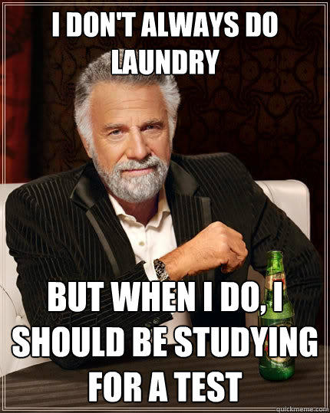
How to Study for the Identification Items
Don’t.
  As I’ve mentioned, I really think you’re better off preparing to write a variety of well-informed, factually grounded essays answers than listing possible IDs and memorizing information out of context.
  Dates in particular are best learned in context. It’s more important to know that Turner’s rebellion closely followed the publication of David Walker’s Appeal and Garrison’s immediatist abolitionist newspaper, The Liberator, than to know that it started on August 21, 1831.
  You’ll pick five items out of nine or ten I’ll give you at the time of the exam. A short (two or three sentence) paragraph for each is sufficient.

Slide 5
How to Study for the Essay Section of the Midterm
Read the question. Think about what it’s asking you to do—Respond to a quotation? Analyze a document? Compare? Explain the causes of an event? . . .
Most of these questions ask you to do more than one thing. For example, all of the quotation questions make several assertions. Be sure to prepare to respond to all aspects of the quote.
After you’ve read the question, think about what resources—book, online reading assignments, material on Blackboard, PowerPoints and lecture notes, etc.—could help you prepare to answer the question. You’re not expected to go beyond the assigned readings. To give a specific example, Wikipedia has many virtues, but reading the Wikipedia entry on Tom Paine or Nat Turner or the Declaration of Independence is no substitute for doing the assigned reading and probably not very helpful as a supplement to assigned reading.
Just a reminder that the syllabus is in the Course Documents section of Blackboard. From there, or from the posting below the syllabus, you can link to the PowerPoints and get to other reading assignments.

Slide 6
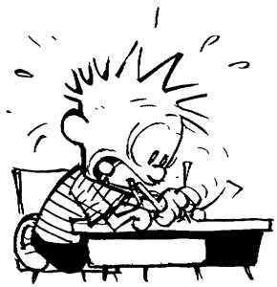
How to Take the Exam
Please read/listen to instructions given at the time of the exam.
Pace yourself. The essay is worth two-thirds of the exam. It makes sense to spend most of your time on that part of the test. You’ll have eighty minutes for the exam. Most people will finish with time to spare. You’re of course welcome to hand in your test and depart at that point.
I don’t care if you do the essay first or the IDs first.

Slide 7
How to Take the Exam (continued)
Before you start writing your essay, read the question again and be sure you know what you want to do to answer it.
Organize your essay. Nothing fancy is needed. An introduction, some paragraphs of development and a summary/conclusion will generally make for a well-structured essay.
Don’t sweat the small stuff: If you can’t remember someone’s first name or the exact date of an event, it’s probably not crucial. Find a way to tell us what you know, not what you don’t recall.
We don’t grade on the basis of writing skills--grammar, spelling, etc.--but a clearly-stated essay will convey what you know and believe better than one that’s written sloppily or one that strives to impress with fancy language.

