Slide 1
1) How Revolutionary was the revolution? 2) Tom Paine—British Failure and International Revolutionary
History 350
April 9, 2015

Slide 2
Reminders and Announcements
Navigating around History 350
Syllabus is the first item in Blackboard Documents
Links to PowerPoints will be posted before each class.
Discussion Forum requirement: In left-hand Blackboard menu, go to Tools→Discussion Board→Read Instructions and First Forum Question→To post, click on link in upper left “Discussion Forum Instructions and Question #1: Tom Paine”→Click on “Create Thread” or respond to an earlier poster. Give your post a subject title and remember to click “submit” when you’re done.
Instructions and options for the short paper due May 26 are in the Assignments section of Blackboard. I recommend that you look them over fairly soon.
My office hours are 1:00-2:30 Tuesdays and Thursdays in 366 McKenzie. I won’t be able to keep office hours next Tuesday, April 14.

Slide 3
Some Websites of Interest
Links to Paine’s other major writings: The American Crisis, The Rights of Man, The Age of Reason and Agrarian Justice
The Thomas Paine National Historical Association website
A British journalist finds echoes of Paine in Obama’s first inaugural address.
Glenn Beck says Tom Paine was the Glenn Beck of his day.
New Yorker article , “The Sharpened Quill”, on Paine, by a leading American historian, Jill Lepore.

Slide 4
Colonial America on the Eve of Revolution: Negative Developments
A “land-population-wealth” crisis brewing
Growing inequality in towns
Greed and fear among western settlers
Southern planters and growing debt
The “Europeanization” of Revolutionary Era America?

Slide 5
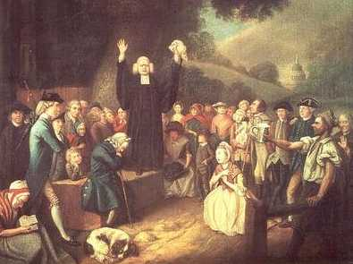
Revolution as Millennium
Evangelical Religion and Political Change
The Great Awakening 1730s and 1740s
Democratizing Religion?
Expanding political participation?
The Revolution as “God’s own cause.”
Revolution to change the whole world from “a vale of tears into a paradise of God.”

Slide 6
Revolution as Consumer Protest
Imported luxuries as threats to personal independence and integrity
Non-importation as an organizing strategy

Slide 7
“Address to the Ladies” 1767 Boston
Address to the LADIES.
Young ladies in town, and those that live round,
Let a friend at this season advise you :
Since money's so scarce, and times growing worse
Strange things may soon hap and surprize you :
First then, throw aside your high top knots of pride
Wear none but your own country linnen ;
of Oeconomy boast, let your pride be the most
What, if homespun they say is not quite so gay
As brocades, yet be not in a passion,
For when once it is known this is much wore in town,
One and all will cry out, 'tis the fashion !
And as one, all agree that you'll not married be
To such as will wear London Fact'ry :
But at first sight refuse, tell'em such you do chuse
As encourage our own Manufact'ry.
No more Ribbons wear, nor in rich dress appear,
Love your country much better than fine things

Slide 8
A Revolutionary Revolution?
Even before the Revolution, some in the upper classes worried about its possible impact
“When the pot boils, the scum will rise.”—James Otis, a leading Boston opponent of British policies
1776: John Adams worries about the threat to social order: “We have been told that our struggle has loosened the bonds of government everywhere; that children and apprentices were disobedient; that schools and colleges were grown turbulent; that Indians slighted their guardians, and negroes grew insolent to their masters.”

Slide 9
New Yorkers pull down a statue of King George III.

Slide 10
What Did the Revolution Change?
Democracy?
Popular Sovereignty--End to Monarchy
Constitution to Guarantee Rights, not to Grant Rights
From Deference to Individualism?
Limited social-economic change

Slide 11
Who Won? Who Lost?
For white men: Extension of voting rights and rights to hold public office
Westward expansion
The Revolution and African Americans:
Gradual emancipation in the North
Expansion of slavery in the plantation South
Jefferson’s criticism of the slave trade, deleted from his draft of the Declaration of Independence
Native Americans and the European American onslaught
Limited advances for white women

Slide 13
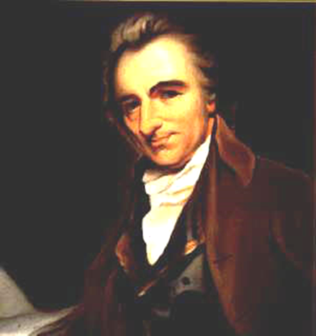
Paradoxes of Paine
Failure and Fame
American nationalist and international revolutionary
Radical and "advocate for commerce"

Slide 14
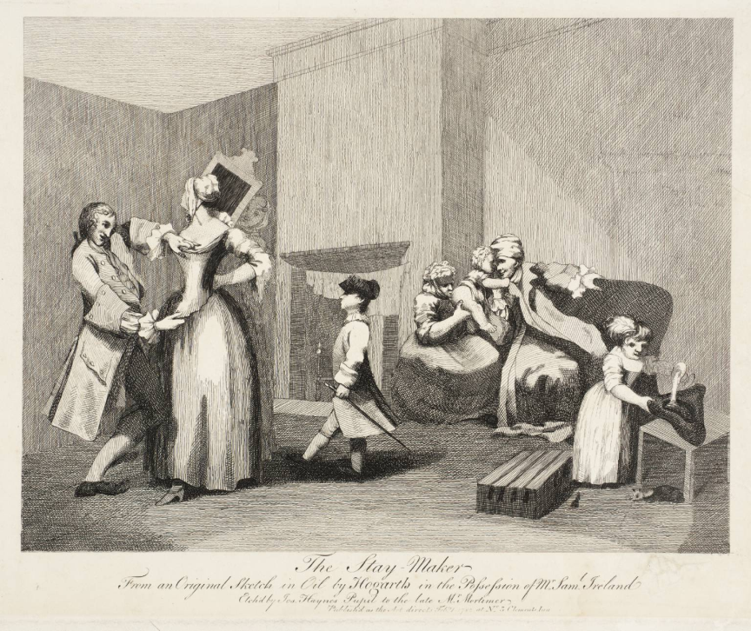
A Life of Disappointments 1737-1774
A conflicted childhood
Limited formal education
A Staymaker’s Life?
A widower and a divorcé
Working for the Man: Paine as
tax collector
Engraving of a staymaker at work, 1782

Slide 15
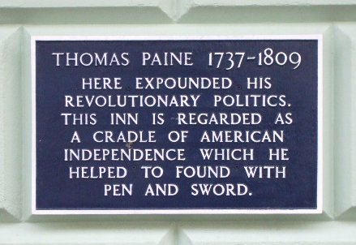
Paine Commemorated in Lewes, England

Slide 16
Paine Complains

Slide 17
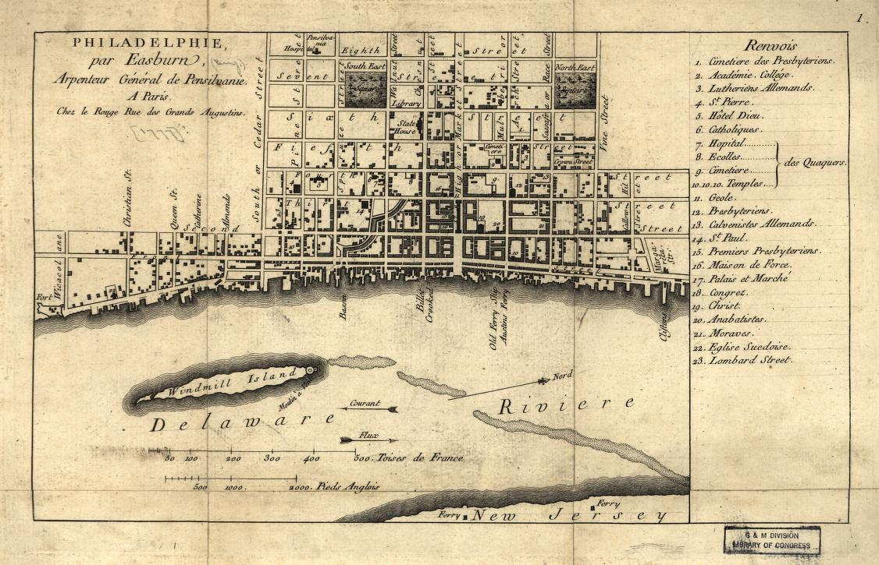
To America 1774
A letter of recommendation from Ben Franklin for work as a tutor, clerk or assistant surveyor
A sickening voyage
Paine’s Philadelphia
Editing the Pennsylvania Magazine

Slide 18
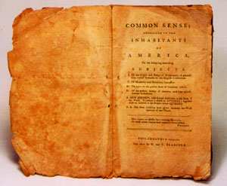
Common Sense
From “Plain Truth” to Common Sense
Publication January 1776
Popularity—100,000 (?) sold in first year
George Washington: Common Sense is “working a powerful change…in the Minds of many Men.”
Criticisms: John Adams calls it “a poor, ignorant, malicious, short-sighted crapulous mass.”

Slide 19
Tone and Style: Reason and Rage
Language: “As it is my design to make those that can scarcely read understand, I shall avoid every literary ornament and put it in language as plain as the alphabet.”
“Plain truth. . . in plain terms”
Biblical References
First person plural “What is it that we want?”
Personifying the enemy: King George III as a “royal brute”
Demanding immediate action

Slide 20
Common Sense: The Message
Independence
Republican Government
American Nationalism

Slide 21
Paine as War Correspondent
The American Crisis
An immigrant’s patriotism: “THESE are the times that try men's souls. The summer soldier and the sunshine patriot will, in this crisis, shrink from the service of their country; but he that stands by it now, deserves the love and thanks of man and woman. Tyranny, like hell, is not easily conquered; yet we have this consolation with us, that the harder the conflict, the more glorious the triumph.”

Slide 22
Paine and the New Nation
Diplomacy and finance
Negotiations with Native Americans: “Among the Indians of North American, there is not…any of those spectacles of human misery which poverty and want present to our eyes in all the towns and streets in Europe.”

Slide 23
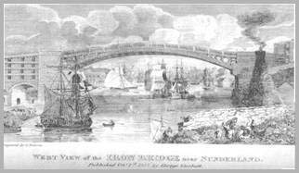
Paine the Bridge-Builder
Designing a single-arch iron bridge
Thomas Jefferson: “Mr Paine, the author of Common Sense, has invented an iron bridge, which promises to be cheaper by a great deal than stone, and to admit of a much greater arch.”
Bridge over River Wear, England, using some of the iron from the model Paine had constructed in London:

