Slide 1
Rights, Wrongs and Revolution
History 350
April 7, 2015

Slide 2
Reminders and Announcements
Navigating around History 350
Syllabus is the first item in Blackboard Documents
Links to PowerPoints will be posted before each class.
Discussion Forum requirement: In left-hand Blackboard menu, go to Tools→Discussion Board→Read Instructions and First Forum Question→To post, click on link in upper left “Discussion Forum Instructions and Question #1: Tom Paine”→Click on “Create Thread” or respond to an earlier poster. Give your post a subject title and remember to click “submit” when you’re done.
Instructions and options for the short paper due May 26 are in the Assignments section of Blackboard. I recommend that you look them over fairly soon.
My office hours are 1:00-2:30 Tuesdays and Thursdays in 366 McKenzie. I won’t be able to keep office hours next Tuesday, April 14.

Slide 3
Some Websites of Interest
Online exhibit on the coming of the Revolution—good documents
Slide show on 18th century millennialism.
Large collection of Revolutionary-era documents
Another broad documentary collection

Slide 4
Factoid of the Day
From a report issued in 2006 by a conservative research group on "civic literacy": "College seniors are also ignorant of America's founding documents. Fewer than half, 47.9 percent, recognized that the line 'We hold these truths to be self-evident, that all men are created equal,' is from the Declaration of Independence."

Slide 5
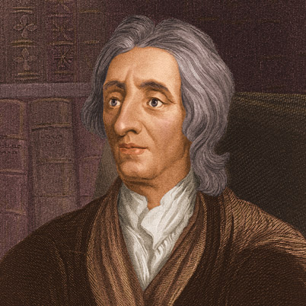
Asserting Rights
What is a right? A natural right? An unalienable right?
Where do rights come from?
How do we know we have rights?
The Lockean Paradox:
Governments exist to protect rights to life, liberty and property
Natural laws come from God’s will and are “writ in the hearts of all mankind”
But: Locke also states: “Let us then suppose the mind to be, as we say, white paper, void of all characters, without any ideas: -- How comes it to be furnished?. . . To this I answer, in one word, from EXPERIENCE.”
So: Do we believe we have rights because God put that belief in our hearts? Or because the society and culture we live in taught us that we do?
John Locke 1632-1704

Slide 6
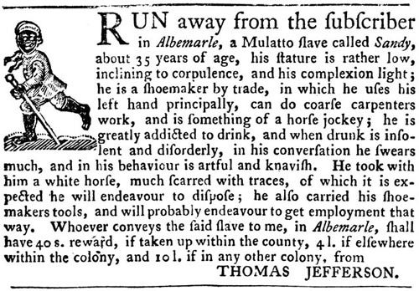
Whose Rights?
Liberty and Slavery
"How is it that we hear the greatest yelps for liberty from the drivers of Negroes?“—Samuel Johnson, British author
Abigail Adams, 1774: Blacks have "as good a right to freedom as we have."
New Hampshire slaves petition for liberty: "Freedom is an inherent right of the human species“
Jun3 2013 news story: “New Hampshire Slaves Granted Posthumous Freedom 234 Years Later”
A 1769 ad from Thomas Jefferson

Slide 7
The Historical Legacy of Claiming Rights
Expanding the Scope of Rights
Race, Gender, Class
Individual and Collective Pursuits of Happiness
Does “Rights Talk” disguise injustice and oppression?
Utilitarianism-- Jeremy Bentham: Natural rights are “simple nonsense: natural and imprescriptible rights, rhetorical nonsense,—nonsense upon stilts.”
The pro-slavery attack on Natural Rights
John C. Calhoun: On the claim that all men are born free and equal, “there is not a word of truth in it. …[All men] are not born free. While infants they are incapable of freedom. . . They grow to all the freedom of which the condition in which they were born permits, by growing to be men. Nor is it less false that they are born "equal." They are not so in any sense in which it can be regarded . . . [T]here is not a word of truth in the whole proposition.”

Slide 8
Listing Grievances
From petitioning the King to attacking the King: “He has refused…”, “He has forbidden…”… and “He has combined with others…”
In every stage of these Oppressions We have Petitioned for Redress in the most humble terms: Our repeated Petitions have been answered only by repeated injury. A Prince whose character is thus marked by every act which may define a Tyrant, is unfit to be the ruler of a free people.
The Declaration as propaganda: “Let facts be submitted to a candid world.”

Slide 9
Justifying Revolution
“Prudence, indeed, will dictate that Governments long established should not be changed for light and transient causes; and accordingly all experience hath shewn, that mankind are more disposed to suffer, while evils are sufferable, than to right themselves by abolishing the forms to which they are accustomed.”
“The history of the present King of Great Britain is a history of repeated injuries and usurpations, all having in direct object the establishment of an absolute Tyranny over these States.”
“And for the support of this Declaration, with a firm reliance on the protection of divine Providence, we mutually pledge to each other our Lives, our Fortunes and our sacred Honor.”

Slide 10
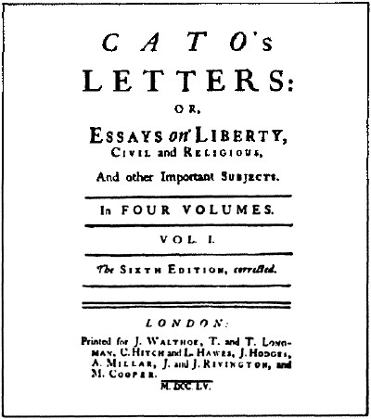
Vigilance or Conspiracy Theory? The Radical Whig Heritage
“Radical Whig” thought: Power vs. Liberty (excerpts here)
Fringe figures in Britain, heroes in the colonies
Power as aggression
Threats to liberty
Taxation
Standing armies
Denial of free speech and press
Threats to property rights
Resistance as duty
John Trenchard and Thomas Gordon’s essays.

Slide 11
How Real Were Colonial Grievances?
Colonial America as a “smiling country”?
“It is not composed, as in Europe, of great lords who possess every thing and of a herd of people who have nothing. Here are no aristocratical families, no courts, no kings, no bishops….; no great manufacturers employing thousands, no great refinements of luxury. The rich and the poor are not so far removed from each other as they are in Europe. We are…united by the silken bands of mild government, all respecting the laws, without dreading their power, because they are equitable.” – Letters from an American Farmer, written before the War for Independence

Slide 12
Colonial America on the Eve of Revolution: Negative Developments
A “land-population-wealth” crisis brewing
Growing inequality in towns
Greed and fear among western settlers
Southern planters and growing debt
The “Europeanization” of Revolutionary Era America?

Slide 13
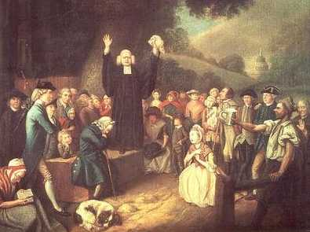
Revolution as Millennium
Evangelical Religion and Political Change
The Great Awakening 1730s and 1740s
Democratizing Religion?
Expanding political participation?
The Revolution as “God’s own cause.”
Revolution to change the whole world from “a vale of tears into a paradise of God.”

Slide 14
Revolution as Consumer Protest
Imported luxuries as threats to personal independence and integrity
Non-importation as an organizing strategy

Slide 15
“Address to the Ladies” 1767 Boston
Address to the LADIES.
Young ladies in town, and those that live round,
Let a friend at this season advise you :
Since money's so scarce, and times growing worse
Strange things may soon hap and surprize you :
First then, throw aside your high top knots of pride
Wear none but your own country linnen ;
of Oeconomy boast, let your pride be the most
What, if homespun they say is not quite so gay
As brocades, yet be not in a passion,
For when once it is known this is much wore in town,
One and all will cry out, 'tis the fashion !
And as one, all agree that you'll not married be
To such as will wear London Fact'ry :
But at first sight refuse, tell'em such you do chuse
As encourage our own Manufact'ry.
No more Ribbons wear, nor in rich dress appear,
Love your country much better than fine things

Slide 16
A Revolutionary Revolution?
Even before the Revolution, some in the upper classes worried about its possible impact
“When the pot boils, the scum will rise.”—James Otis, a leading Boston opponent of British policies
1776: John Adams worries about the threat to social order: “We have been told that our struggle has loosened the bonds of government everywhere; that children and apprentices were disobedient; that schools and colleges were grown turbulent; that Indians slighted their guardians, and negroes grew insolent to their masters.”

Slide 17
New Yorkers pull down a statue of King George III.

Slide 18
What Did the Revolution Change?
Popular Sovereignty--End to Monarchy
Constitution to Guarantee Rights, not to Grant Rights
From Deference to Individualism?
Limited social-economic change
Gradual end of slavery in the North but slavery generally strengthened in the South

