Slide 1
Nat turner: Revolutionary Hero or Madman?
History 350
April 23, 2015

Slide 2
Reminders and Announcements
Navigating around History 350
Syllabus is the first item in Blackboard Documents
Links to PowerPoints will be posted on the syllabus before each class. Scroll down to the date of the class and click on the date. The syllabus will also lead you to some readings, assignment information, etc.
Discussion Forum requirement: In left-hand Blackboard menu, go to Tools→Discussion Board→Read Instructions and First Forum Question→To post, click on link in upper left “Discussion Forum Instructions and Question #1: Tom Paine”→Click on “Create Thread” or respond to an earlier poster. Give your post a subject title and remember to click “submit” when you’re done.
The second Discussion Forum (on Nat Turner’s revolt) is now online. Deadline is May 12. Deadline for your post to the first forum (on Paine) is April 28.
There will be four forums during the term. You need to respond to three of them.
Instructions and options for the short paper due May 26 are in the Assignments section of Blackboard. I recommend that you look them over fairly soon.

Slide 3
Announcements: Nat Turner: A Troublesome Property
Nat Turner: A Troublesome Property is a “docudrama” about the most famous U.S. slave rebellion leader. I’ll show it in class next Thursday, April 30. I’ve put a copy of the DVD on reserve: If you miss that class, I strongly recommend that you watch it in the Knight Library AV room, on the third floor. It’s about sixty minutes long.
In the remaining class time on April 30 (and maybe for a few minutes more), I’ll hold a brief midterm exam review session. Attendance at the review is optional.

Slide 4
Announcements: Midterm Exam May 5
I’ve posted the instructions and possible essay questions for the midterm exam at http://pages.uoregon.edu/dapope/350midtermessays.htm.

Slide 5
Some Websites of Interest: Slave Revolts
“The Abolition Project” section on slave resistance
Archeology of the Quilombo dos Palmares, African-Brazilian rebel community
Creativity and Resistance—Smithsonian Institution exhibit on Maroon (escaped slave) colonies in the Americas
Website for Nat Turner: A Troublesome Property (film we’ll see on May 1)
Brief description and documents on Gabriel Prosser’s conspiracy, Richmond, 1800
Religion and Denmark Vesey’s rebellion, Charleston, SC, 1822
A recent online article on “The Five Greatest Slave Rebellions in U.S. History”.

Slide 6
Explaining Differences: The Elkins Thesis
About fifty years ago, historian Stanley Elkins (in his book simply entitled Slavery) presented a controversial theory about why the U.S. South had fewer and smaller revolts than the rest of the Western Hemisphere.
The Slave South as “unopposed capitalist” society
Slavery as a “total institution”
Psychologist Erving Goffman defines “total institution”: A total institution may be defined as a place of residence and work where a large number of like-situated individuals, cut off from the wider society for an appreciable period of time, together lead an enclosed, formally administered round of life.
Psychological impacts: Loss of adult roles, “infantilization”?
Reception and Debate

Slide 7
Explaining Differences: More Recent Approaches
Demography
Geography
Escape potential
Arms? Larry Ward, chairman of “Gun Appreciation Day,” January 2013: "I think Martin Luther King, Jr. would agree with me if he were alive today that if African Americans had been given the right to keep and bear arms from day one of the country’s founding, perhaps slavery might not have been a chapter in our history."

Slide 8
Day to Day Survival and Resistance
Creating and maintaining slave communities
Slave families
Religion: An African American Christianity
Forms of resistance:
Sabotage
Avoiding work discipline
Attacks—arson, poisoning…--against masters
Escape

Slide 9
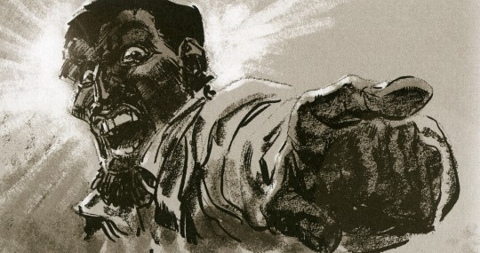
The Enigma of Nat Turner
Delusionary Madman?
Revolutionary Organizer?

Slide 10
The Setting: David Walker’s Appeal
Link to Walker’s appeal
Walker, born in North Carolina, was a free African American living in Boston
His Appeal to the Colored Citizens of the World, published 1829
"America is as much our country, as it is yours.--Treat us like men, and there is no danger but we will all live in peace and happiness."
“I ask you, had you not rather be killed than to be a slave to a tyrant, who takes the life of your mother, wife, and dear little children? Look upon your mother, wife and children, and answer God Almighty; and believe this, that it is no more harm for you to kill a man, who is trying to kill you, than it is for you to take a drink of water when thirsty; in fact, the man who will stand still and let another murder him, is worse than an infidel….”

Slide 11
The Setting: Abolitionism and “Immediate Emancipation”
Shift from optimism that slavery would fade away to belief that slavery was a sinful institution that American whites needed to reject immediately.
William Lloyd Garrison begins publication of The Liberator January 1831: “I will be as harsh as truth, and uncompromising as justice... I am in earnest, I will not equivocate, I will not excuse, I will not retreat a single inch, and I will be heard.”
Rejection of schemes for colonization of former slaves outside the United States
Nonviolence—emancipation by “moral suasion”

Slide 12
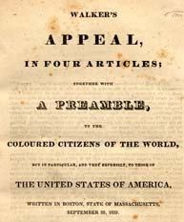
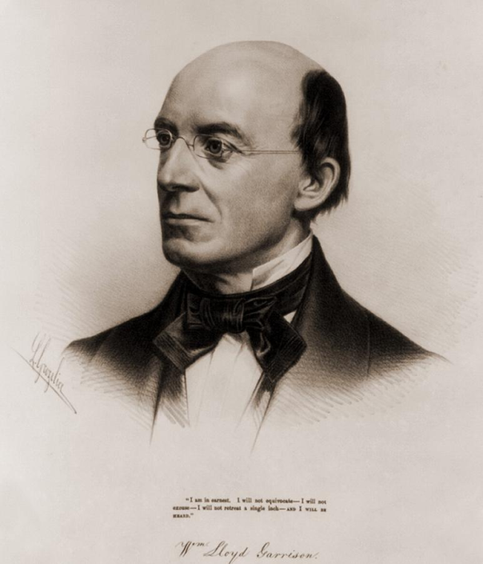
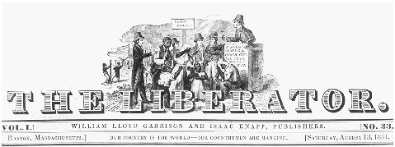
David Walker’s Appeal/William Lloyd Garrison and The Liberator

Slide 13
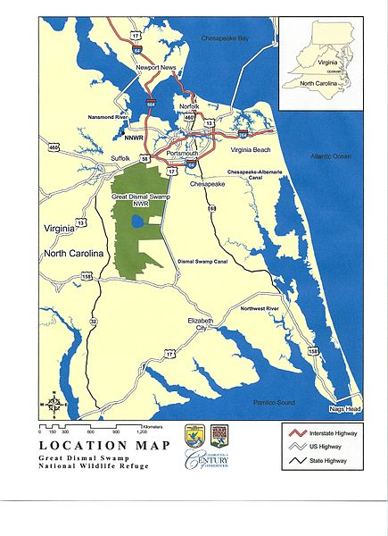
The Setting: Southampton County, Virginia 1831
Great Dismal Swamp
Population
Slavery in Virginia
Local conditions
Free Black community

Slide 14
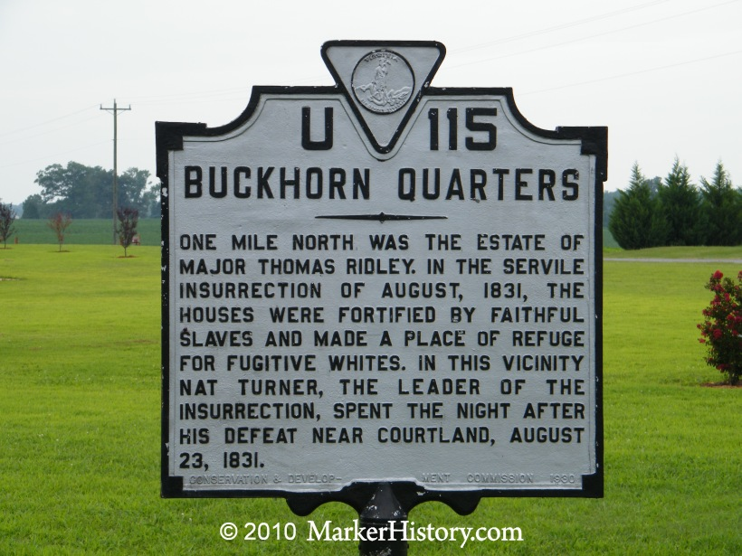
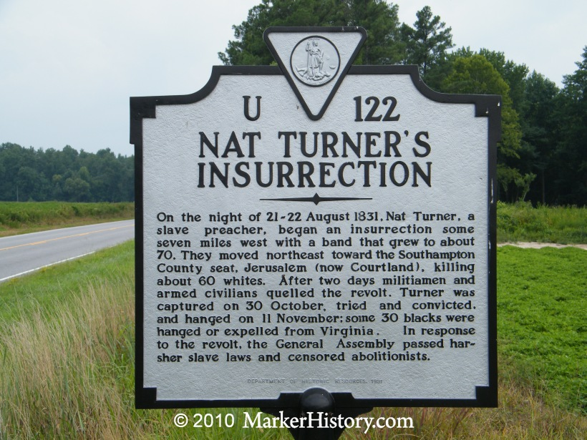
Roadside Turner

Slide 15
Making Nat Turner
Childhood and before
Preparing for greatness? “Having soon discovered [myself] to be great, I must appear so, and therefore studiously avoided mixing in society, and wrapped myself in mystery, devoting myself to fasting and prayer.”
Turner as preacher
Image of Turner preaching

Slide 16
Turner’s Goals
Vengeance?
Escape?
Overthrow?
“The Spirit instantly appeared to me and said the Serpent was loosened…and that I should take [Christ’s yoke] on and fight against the serpent, for the time was fast approaching when the first should be last and the last should be first.”

Slide 17
The Revolt
Preparation and recruitment
Timing
Strategy and Tactics
A famous historian has written: “…Revolutionaries …must conclude that they will have no prospects until the cost of collaboration rises to the level of the cost of rebellion…. And it serves no purpose to pretend that ‘innocent’—personally inoffensive and politically neutral—people should be spared. The oppressor needs nothing so much as political neutrality to do business as usual…. He who wills liberation in a context that does not permit peaceful change wills revolutionary terror. No slave revolt that hesitated to invoke terror had a chance.”

Slide 18
Turner’s Revolt Defeated
Capture, trial and execution
At right: sketch of Turner’s capture
Repressive violence
Thomas Gray’s “The Confessions of Nat Turner”

Slide 19
The Aftermath
Virginia Debates Slavery
Governor Floyd: : "Before I leave this government, I will have contrived to have a law passed gradually abolishing slavery in this state, or at all events to begin the work by prohibiting slavery west of the blue ridge Mountains.“
In the end, slave codes were strengthened; prohibitions on schools, religious gatherings and preaching.
Thomas Dew and the Positive Good Defense of Slavery: “No insurrection of this kind can occur where the blacks are as much civilized as they are in the United States….[T]he negro of the United States has imbibed the principles, the sentiments, and feelings of the white; in one word, he is civilized—at least comparatively.”

Slide 20
The Aftermath
William Lloyd Garrison responds: “We are horror-struck at the late tidings….”
“I do not justify the slaves in their rebellion; yet I do not condemn them and applaud similar conduct in white men. I deny the right of any people to fight for their liberty….Of all men living, however, our slaves have the best reason to assert their rights by violent means.”
An African American newspaper in Albany, NY: “Their struggle for freedom is the same in principle as the struggle of our fathers in ‘76. I hope they may achieve their liberty eventually by fair and honorable means, in a brave and manly conflict with their masters.”

Slide 21
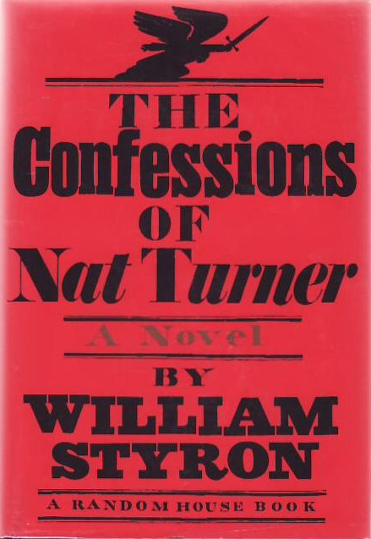
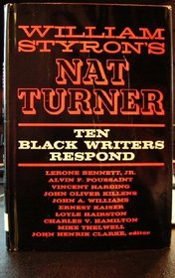
Nat Turner in Memory and Imagination
Turner as inspiration: African American journalist T. Thomas Fortune writes in 1889: “Nat Turner was a black hero. He preferred death to slavery. He ought to have a monument.”
William Styron and The Confessions of Nat Turner (published 1967)

