Slide 1
Slave Revolts and Resistance: Comparative Perspectives and the Context of Turner’s Rebellion
History 350
April 21, 2015

Slide 2
Reminders and Announcements
Navigating around History 350
Syllabus is the first item in Blackboard Documents
Links to PowerPoints will be posted on the syllabus before each class. Scroll down to the date of the class and click on the date. The syllabus will also lead you to some readings, assignment information, etc.
Discussion Forum requirement: In left-hand Blackboard menu, go to Tools→Discussion Board→Read Instructions and First Forum Question→To post, click on link in upper left “Discussion Forum Instructions and Question #1: Tom Paine”→Click on “Create Thread” or respond to an earlier poster. Give your post a subject title and remember to click “submit” when you’re done.
The second Discussion Forum (on Nat Turner’s revolt) is now online. Deadline is May 12. Deadline for the post to the first forum (on Paine) is April 28.
There will be four forums during the term. You need to respond to three of them.
Instructions and options for the short paper due May 26 are in the Assignments section of Blackboard. I recommend that you look them over fairly soon.

Slide 3
Announcements: Continued
The midterm exam is Tuesday, May 5. At least a week before it, I’ll post potential essay questions for the exam. At the time of the exam, I’ll eliminate some of the posted questions and ask you to choose one of the essay questions to answer. You’ll have at least three questions to choose from. The essay is worth two-thirds of the exam.
There will also be brief identifications. I’ll offer nine or ten items drawn from readings and class sessions. You’ll choose five to answer. The identifications will be worth one-third of the exam.
The midterm is a closed-book, no-notes exam. You’ll have the full class period (80 minutes) for it.

Slide 4
Some Websites of Interest: Slave Revolts
“The Abolition Project” section on slave resistance
Archeology of the Quilombo dos Palmares, African-Brazilian rebel community
Creativity and Resistance—Smithsonian Institution exhibit on Maroon (escaped slave) colonies in the Americas
Website for Nat Turner: A Troublesome Property (film we’ll see on May 1)
Brief description and documents on Gabriel Prosser’s conspiracy, Richmond, 1800
Religion and Denmark Vesey’s rebellion, Charleston, SC, 1822

Slide 5
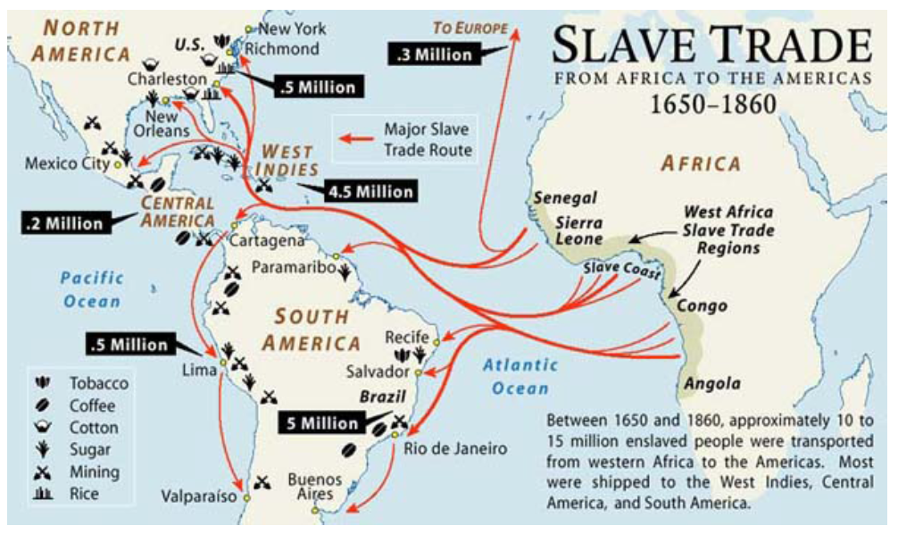
Slavery and Slave Revolts
Was slavery itself the cause of slave revolts?
Plantation Slavery: The Western Hemisphere

Slide 6
Comparative Perspectives on Slave Revolts
Frequency
Size
Success

Slide 7
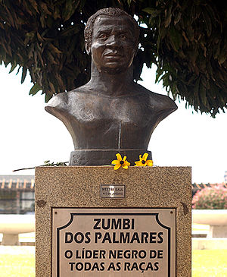
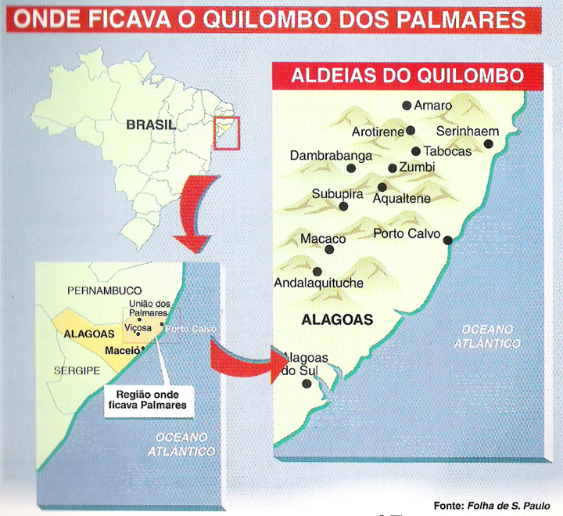
Brazil: Quilombo of Palmares
Zumbi—Leader of Palmares Afro-Brazilian Community
Map Showing Location of Escaped Slave Quilombo 1605-1694

Slide 8
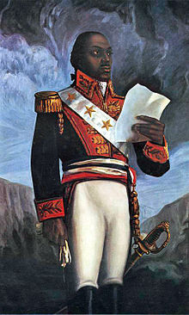
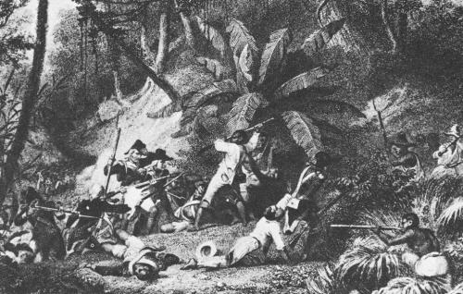
Haitian Revolution 1791-1804
Toussaint L’Ouverture

Slide 9
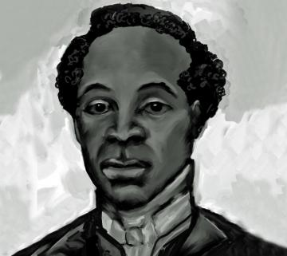
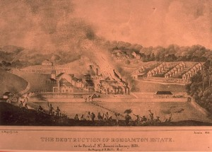
Jamaican Slave Revolt 1831
Rebels Attack a Plantation
Sam Sharpe Revolt Leader

Slide 10
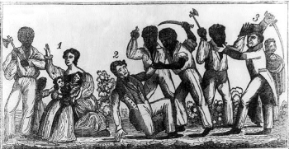
U.S. Rebellions before Nat Turner: Stono Rebellion 1739
Colonial North America: Stono Rebellion, South Carolina 1739

Slide 11
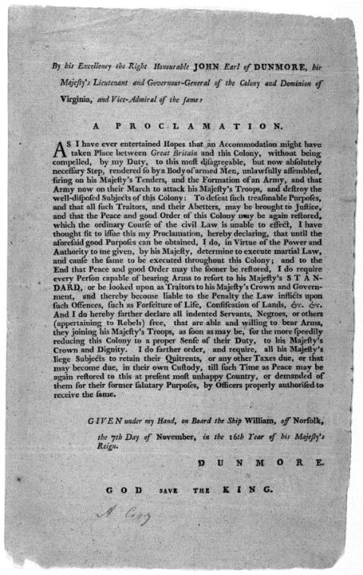
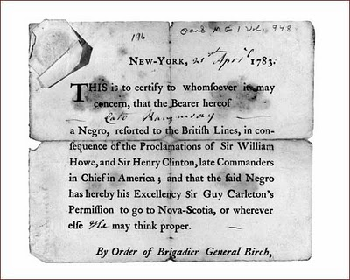
American Revolution and Slave Escape and Resistance
1775 British General Lord Dunmore’s Proclamation offers freedom to slaves who escape and join British troops
Escape, manumission and—in the North—gradual abolition of slavery.

Slide 12
Gabriel’s Rebellion, Richmond, VA 1800
Gabriel Prosser’s Conspiracy
Portrait of Gabriel Prosser
Prosser a literate, skilled blacksmith
Plan to march on Richmond
Heavy rains wash out bridge
Capture and repression
Influence of American and Haitian Revolutions
At trial, one slave reportedly says, "I have nothing more to offer than what General Washington would have had to offer, had he been taken by the British....”
2007: Virginia Governor pardons Gabriel Prosser

Slide 13
Denmark Vesey Rebellion, Charleston, SC, 1822
Vesey had purchased his own freedom after winning a lottery
Aware of ongoing political debates about expansion of slavery
Told followers that “children of Israel were delivered out of Egypt from bondage.”
Plot betrayed? Or fabricated by extremist white slaveowners?
Denmark Vesey Memorial

Slide 14
Explaining Differences: The Elkins Thesis
About fifty years ago, historian Stanley Elkins (in his book simply entitled Slavery) presented a controversial theory about why the U.S. South had fewer and smaller revolts than the rest of the Western Hemisphere.
The Slave South as “unopposed capitalist” society
Slavery as a “total institution”
Psychological impacts
Reception and Debate

Slide 15
Explaining Differences: More Recent Approaches
Demography
Geography
Escape potential
Arms? Larry Ward, chairman of “Gun Appreciation Day,” January 2013: "I think Martin Luther King, Jr. would agree with me if he were alive today that if African Americans had been given the right to keep and bear arms from day one of the country’s founding, perhaps slavery might not have been a chapter in our history."

Slide 16
Day to Day Survival and Resistance
Creating and maintaining slave communities
Slave families
Religion: An African American Christianity
Forms of resistance:
Sabotage
Avoiding work discipline
Attacks—arson, poisoning…--of masters
Escape

Slide 17
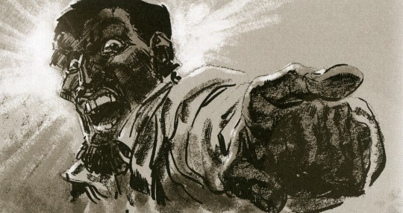
The Enigma of Nat Turner
Delusionary Madman?
Revolutionary Organizer?

Slide 18
The Setting: David Walker’s Appeal
Link to Walker’s appeal
Walker, born in North Carolina, was a free African American living in Boston
His Appeal to the Colored Citizens of the World, published 1829
"America is as much our country, as it is yours.--Treat us like men, and there is no danger but we will all live in peace and happiness."
“I ask you, had you not rather be killed than to be a slave to a tyrant, who takes the life of your mother, wife, and dear little children? Look upon your mother, wife and children, and answer God Almighty; and believe this, that it is no more harm for you to kill a man, who is trying to kill you, than it is for you to take a drink of water when thirsty; in fact, the man who will stand still and let another murder him, is worse than an infidel….”

Slide 19
The Setting: “Immediatist” Abolitionism
Shift from optimism that slavery would fade away to belief that slavery was a sinful institution that American whites needed to reject immediately.
Rejection of schemes for colonization of former slaves outside the United States
Nonviolence—emancipation by “moral suasion”
William Lloyd Garrison begins publication of The Liberator January 1831: “I will be as harsh as truth, and uncompromising as justice... I am in earnest, I will not equivocate, I will not excuse, I will not retreat a single inch, and I will be heard.”

Slide 20
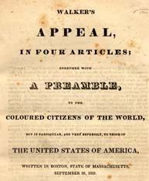
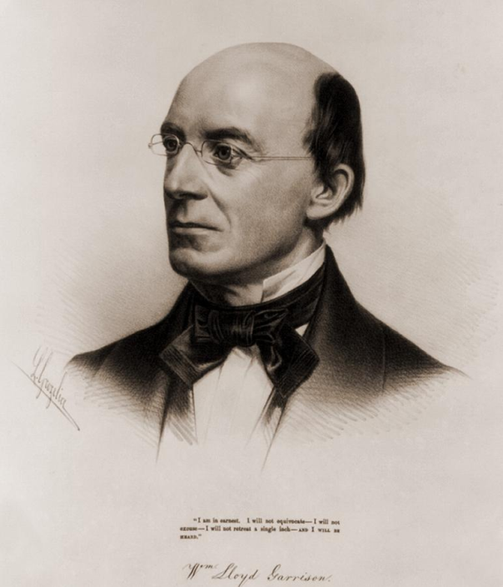
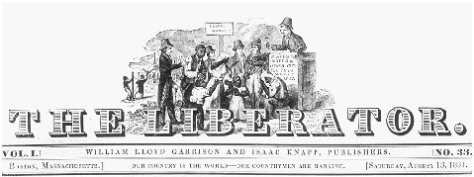
David Walker’s Appeal/William Lloyd Garrison and The Liberator

Slide 21
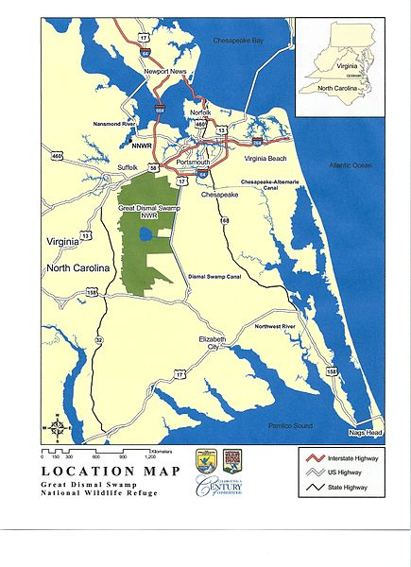
The Setting: Southampton County, Virginia 1831
Great Dismal Swamp
Population
Slavery in Virginia
Local conditions
Free Black community

Slide 22
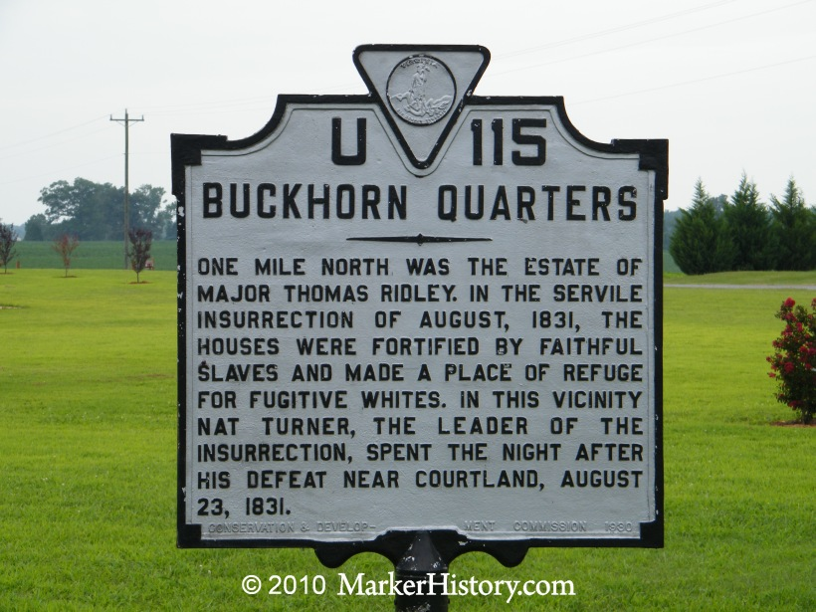
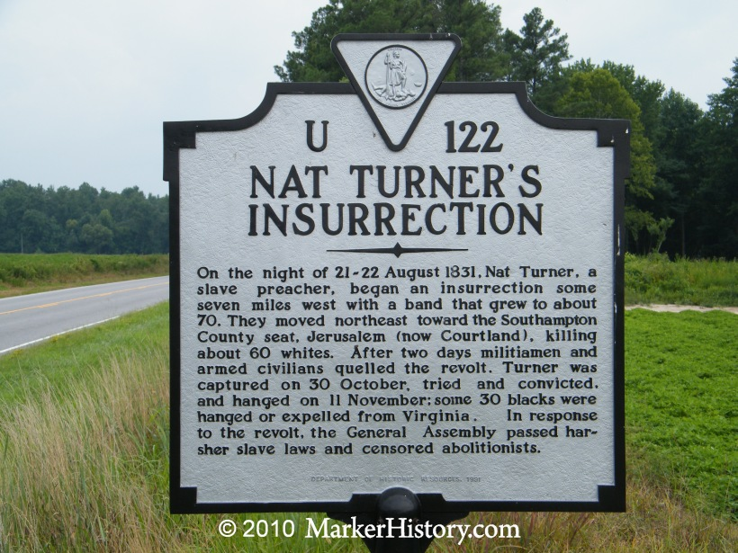
Roadside Turner

Slide 23
Turner’s Goals
Vengeance?
Escape?
Self-Liberation?
Overthrow?

Slide 24
The Revolt
Preparation
Timing
Tactics
Reasons for Defeat

Slide 25
The Consequences
Reprisal and Repression
Virginia Debates Slavery
Governor Floyd: : "Before I leave this government, I will have contrived to have a law passed gradually abolishing slavery in this state, or at all events to begin the work by prohibiting slavery west of the blue ridge Mountains.“
Thomas Dew and the Positive Good Defense of Slavery

