Slide 1
American Revolution or War for Independence?
History 350
April 2, 2015

Slide 2
A Little More Bureaucracy
Navigating around History 350
Syllabus is the first item in Blackboard Documents
Links to PowerPoints will be posted before each class.
Discussion Forum requirement: In left-hand Blackboard menu, go to Tools→Discussion Board→Read Instructions and First Forum Question→To post, click on link in upper left “Discussion Forum Instructions and Question #1: Tom Paine”→Click on “Create Thread” or respond to an earlier poster. Give your post a subject title and remember to click “submit” when you’re done.
Instructions and options for the short paper due May 26 are in the Assignments section of Blackboard. I recommend that you look them over fairly soon.

Slide 3
Some Websites of Interest
A detailed timeline of the coming of the American Revolution
Map of the colonies 1775
“Declaring Independence” Library of Congress exhibit
Website for PBS series “Liberty: The American Revolution”

Slide 4
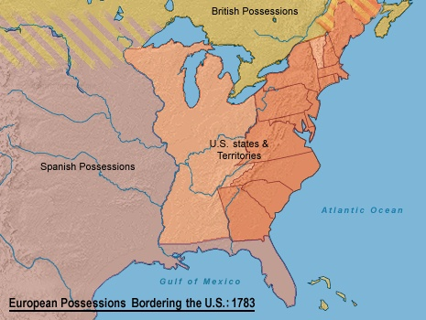
Colonies to Independent Nation: 1775-1783

Slide 5
Was the United States Founded in Revolution?
The Path to War
Colonial Context to 1763
Politics: Imperialism on paper, autonomy in practice
Economics: Colonies as raw materials producer for imperial trade—mercantilism
Military: French and Indian War (1756-1763) and French withdrawal from North American continent; after British victory, France withdraws from North American continent.

Slide 6
A French Diplomat’s Prediction in 1763
"Delivered from a neighbor whom they have always feared, your other colonies will soon discover that they stand no longer in need of your protection. You will call on them to contribute toward supporting the burthen which they have helped to bring on you, they will answer you by shaking off all dependency."

Slide 7
Imperial Reform and Colonial Protest 1763-1766
British Policies: Raise revenue and control frontier
Proclamation of 1763
Stamp Act 1765
Declaratory Act 1766
Taxation without Representation?
Colonists’ Objectives: Avoid imperial taxes and expand westward.
Protests against Stamp Act lead to repeal (1766)
Objections only to “internal” taxes?

Slide 8
Stamp Act Protest in Print

Slide 9
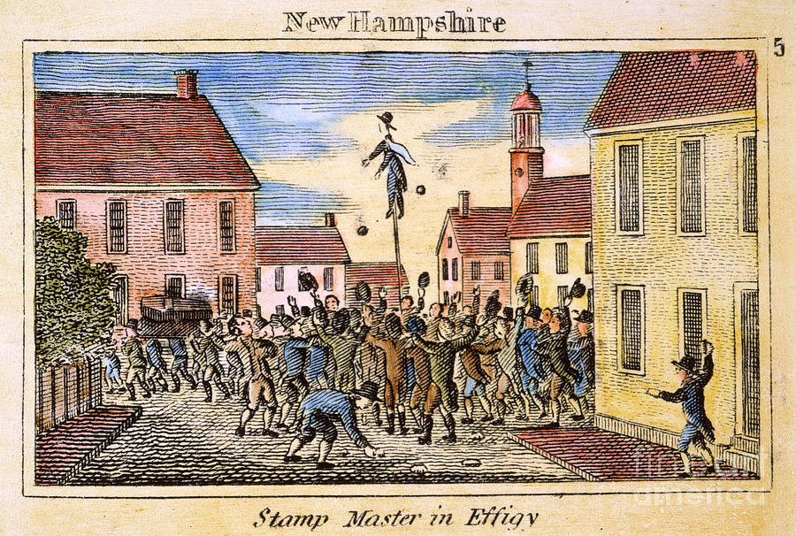
Protest in the Streets

Slide 10
Parliament Reasserts Control 1767-72
British Policy: Revenue from Taxing Trade
Townshend Acts 1767-70
Enforcement by military occupation
Repealed 1770 except for tax on tea
Imperial taxation for revenue or for regulation of trade?
Colonial Protest
Sons of Liberty and Non-Importation
Boycotts as Strategy
Boston Massacre 1770
Period of Calm 1770-72

Slide 11
Paul Revere’s Engraving of the Boston Massacre 1770

Slide 12
Conflict Renewed 1773-1775
British Policy: Aid to British East India Company
Tea Act 1773 gives East India Company monopoly on tea trade with American Colonies
Intolerable Acts 1774 as punishment for Tea Party
Colonial reaction:
Non-importation renewed
Boston Tea Party December 1773
Colonists join together in First Continental Congress, September 1774

Slide 13
Boston Tea Party December 1773

Slide 14
War and Independence 1775-1783
War breaks out: Lexington and Concord, 1775
A Continental Army Forms
1775-76:Colonies declare themselves independent states
1775-76: A Second Continental Congress Declares Independence (July 4, 1776)
1781: British Surrender
1783: Treaty of Paris ends war
[1781-1788: “13 Free and Independent States” in a loose alliance under the Articles of Confederation.]
[1787: Constitutional Convention drafts a new United States Constitution giving greater power to the Federal government]
[1789: George Washington becomes first President]

Slide 15
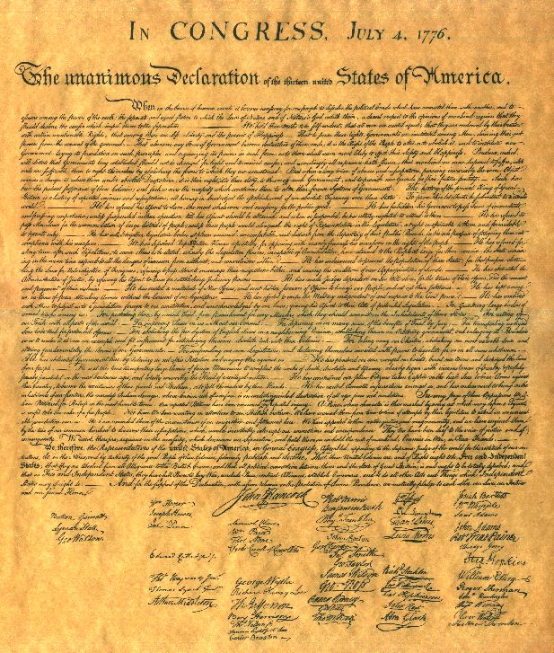
Whose Declaration?
“We hold these truths to be self-evident, that all men are created equal, that they are endowed by their Creator with certain unalienable Rights, that among these are Life, Liberty and the pursuit of Happiness.”
“The history of the present King of Great Britain is a history of repeated injuries and usurpations, all having in direct object the establishment of an absolute Tyranny over these States. To prove this, let Facts be submitted to a candid world.”

Slide 16
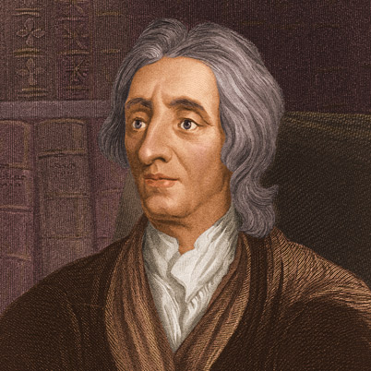
Asserting Rights
What is a right? A natural right? An unalienable right?
Where do rights come from?
How do we know we have rights?
The Lockean Paradox:
Governments exist to protect rights to life, liberty and property
Natural laws come from God’s will and are “writ in the hearts of all mankind”
But: Locke also states: “Let us then suppose the mind to be, as we say, white paper, void of all characters, without any ideas: -- How comes it to be furnished?. . . To this I answer, in one word, from EXPERIENCE.”
So: Do we believe we have rights because God put that belief in our hearts? Or because the society and culture we live in taught us that we do?
John Locke 1632-1704

Slide 17
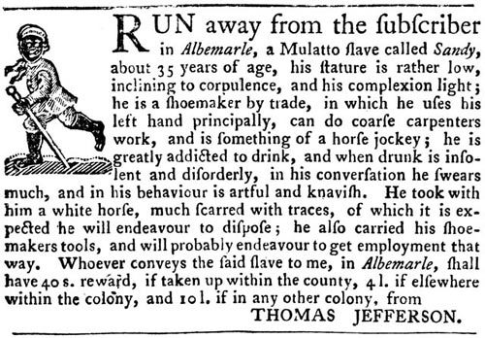
Whose Rights?
Liberty and Slavery
"How is it that we hear the greatest yelps for liberty from the drivers of Negroes?“—Samuel Johnson, British author
Abigail Adams, 1774: Blacks have "as good a right to freedom as we have."
New Hampshire slaves petition for liberty: "Freedom is an inherent right of the human species“
Jun3 2013 news story: “New Hampshire Slaves Granted Posthumous Freedom 234 Years Later”
A 1769 ad from Thomas Jefferson

Slide 18
Listing Grievances
From petitioning the King to attacking the King: “He has refused…”, “He has forbidden…”… and “He has combined with others…”
In every stage of these Oppressions We have Petitioned for Redress in the most humble terms: Our repeated Petitions have been answered only by repeated injury. A Prince whose character is thus marked by every act which may define a Tyrant, is unfit to be the ruler of a free people.
The Declaration as propaganda: “Let facts be submitted to a candid world.”

Slide 19
Justifying Revolution
“Prudence, indeed, will dictate that Governments long established should not be changed for light and transient causes; and accordingly all experience hath shewn, that mankind are more disposed to suffer, while evils are sufferable, than to right themselves by abolishing the forms to which they are accustomed.”
“The history of the present King of Great Britain is a history of repeated injuries and usurpations, all having in direct object the establishment of an absolute Tyranny over these States.”
“And for the support of this Declaration, with a firm reliance on the protection of divine Providence, we mutually pledge to each other our Lives, our Fortunes and our sacred Honor.”

Slide 20
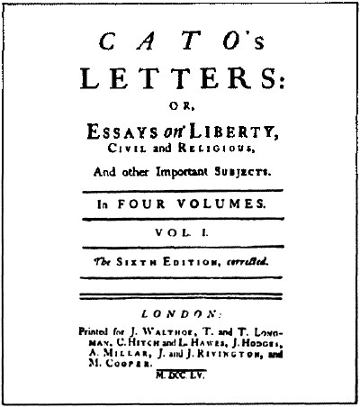
Vigilance or Conspiracy Theory? The Radical Whig Heritage
“Radical Whig” thought: Power vs. Liberty (excerpts here)
Fringe figures in Britain, heroes in the colonies
Power as aggression
Threats to liberty
Taxation
Standing armies
Denial of free speech and press
Threats to property rights
Resistance as duty
John Trenchard and Thomas Gordon’s essays.

