Slide 1
1) The Death and Rebirth of Tom Paine 2) Slave Revolts: History and Geography
History 350
April 16, 2015

Slide 2
Reminders and Announcements
Navigating around History 350
Syllabus is the first item in Blackboard Documents
Links to PowerPoints will be posted before each class.
Discussion Forum requirement: In left-hand Blackboard menu, go to Tools→Discussion Board→Read Instructions and First Forum Question→To post, click on link in upper left “Discussion Forum Instructions and Question #1: Tom Paine”→Click on “Create Thread” or respond to an earlier poster. Give your post a subject title and remember to click “submit” when you’re done.
Deadline for the post to the first forum is April 28. I’ll post the second forum prompt next week.
There will be four forums during the term. You need to respond to three of them.
Instructions and options for the short paper due May 26 are in the Assignments section of Blackboard. I recommend that you look them over fairly soon.

Slide 3
Announcements: Continued
The midterm exam is Tuesday, May 5. At least a week before it, I’ll post potential essay questions for the exam. At the time of the exam, I’ll eliminate some of the posted questions and ask you to choose one of the essay questions to answer. You’ll have at least three questions to choose from. The essay is worth two-thirds of the exam.
There will also be brief identifications. I’ll offer nine or ten items drawn from readings and class sessions. You’ll choose five to answer. The identifications will be worth one-third of the exam.
The midterm is a closed-book, no-notes exam. You’ll have the full class period (80 minutes) for it.

Slide 4
Some Websites of Interest: Paine
Links to Paine’s other major writings: The American Crisis, The Rights of Man, The Age of Reason and Agrarian Justice
The Thomas Paine National Historical Association website
A British journalist finds echoes of Paine in Obama’s first inaugural address.
Glenn Beck says Tom Paine was the Glenn Beck of his day.
New Yorker article , “The Sharpened Quill”, on Paine, by a leading American historian, Jill Lepore.
The “Edmund Burke Institute for American Renewal” celebrates its hero, Paine’s opponent.
Burke’s conservatism extended to gender relations, as you can see on a website called “Chivalry Now”:
New Rochelle, NY seeks to honor Paine

Slide 5
Some Websites of Interest: Slave Revolts
“The Abolition Project” section on slave resistance
Archeology of the Quilombo dos Palmares, African-Brazilian rebel community
Creativity and Resistance—Smithsonian Institution exhibit on Maroon (escaped slave) colonies in the Americas
Website for Nat Turner: A Troublesome Property (film we’ll see on May 1)
Brief description and documents on Gabriel Prosser’s conspiracy, Richmond, 1800
Religion and Denmark Vesey’s rebellion, Charleston, SC, 1822

Slide 6
Tom Paine in the News
(from Salon.com, 2011)
“Roger Stockham, a 63-year-old Army veteran from California who was reportedly angry at the U.S. government, was arrested by police in Michigan and charged with allegedly threatening to blow up a Mosque in Dearborn.
“Dearborn police allegedly found Stockham inside his vehicle outside the Islamic Center of America with a load of M-80s in his trunk and other explosives, the Detroit News reported….
“On a MySpace profile that appears to belong to Stockham, he writes that he's happy with how much he's lived. "Ready for it to be over, but have a policy I contend with often: So long as I am alive, I can't play dead," he apparently wrote.
“He writes that he has "four ex-wives" and is "on meds and doing better than my history would predict." He lists his heroes as Thomas Jefferson and "Tom Payne" [sic].”

Slide 7
Hero and Victim
Honorary Citizen, member of French Convention 1792-93
American Revolution as inspiration for the French: “That the principles of America opened the Bastille is not to be doubted.”
Opposes execution of King Louis XVI and Queen Marie Antoinette
Imprisoned 1793-94
The Age of Reason: “The word of God is the creation we behold.”
Christianity is “too absurd for belief, too impossible to convince, and too inconsistent for practice. It . . . produces only atheists and fanatics.

Slide 8
Back to America, 1802-1809
Paine in France after release from prison: “This is not a country for an honest man to live in; they do not understand any thing at all of the principles of free government, and the best way is to leave them to themselves….I know of no Republic in the world except America, which is the only country for such men as you and I.”
Back to New York area, 1802
Jefferson shuns him and few defend him.
Illness and obscurity
Death, 1809: Six people attend his funeral
A hostile epitaph:
Blasphemes the Almighty, lives in filth like a hog,
Is abandoned in death and interred like a dog.

Slide 9
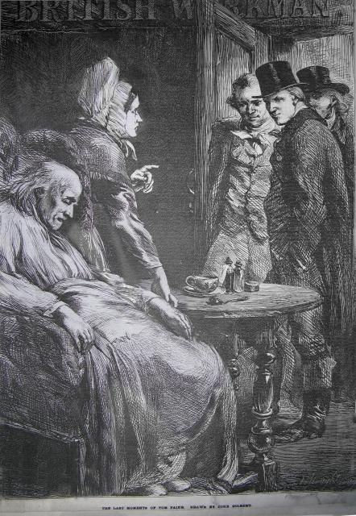
Paine’s Death
“One by one most of his old friends and acquaintances had deserted him. . . . He was a victim of the people, but his convictions remained unshaken. He was still a soldier in the army of freedom, and still tried to enlighten and civilize those who were impatiently waiting for his death. Even those who loved their enemies hated him, their friend – the friend of the whole world – with all their hearts. On the 8th of June, 1809, death came – Death, almost his only friend. At his funeral no pomp, no pageantry, no civic procession, no military display. In a carriage, a woman and her son who had lived on the bounty of the dead – on horseback, a Quaker, the humanity of whose heart dominated the creed of his head and, following on foot, two negroes filled with gratitude – constituted the funeral cortege of Thomas Paine.'' Robert Green Ingersoll

Slide 10
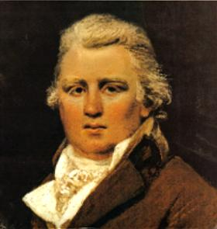
Tom Paine’s Bones
British pamphleteer William Cobbett turns from enemy to admirer
1819: To America to exhume Paine’s remains
Plan to rebury him in England with a monument in his honor
Can’t raise the funds
Where’s Tom?
A 2001 report on his whereabouts
Watch a video of “Tom Paine’s Bones”
Lyrics here
William Cobbett

Slide 11
Paine’s Revival
''I consider Paine our greatest political thinker. As we have not advanced, and perhaps never shall advance, beyond the Declaration and Constitution, so Paine has had no successors who extended his principles.'' Thomas Edison
Paine deserves “a place in the hearts of all lovers of liberty.”—Andrew Jackson
The Age of Reason converts Lincoln to Deism as a young man
Walt Whitman, Susan B. Anthony, Eugene Victor Debs are all admirers of Paine.
In World War II, General George Patton quotes Common Sense to his troops: “Tyranny, like Hell, is not easily conquered.”
Ronald Reagan borrows from Paine: “We have it in our power to begin the world over again.”

Slide 12
Who Was Tom Paine?
Paine as political theorist or as agitator?
Paine as “artisan republican”
Paine’s republicanism vs. American liberal individualism?
Paine and James Madison

Slide 13
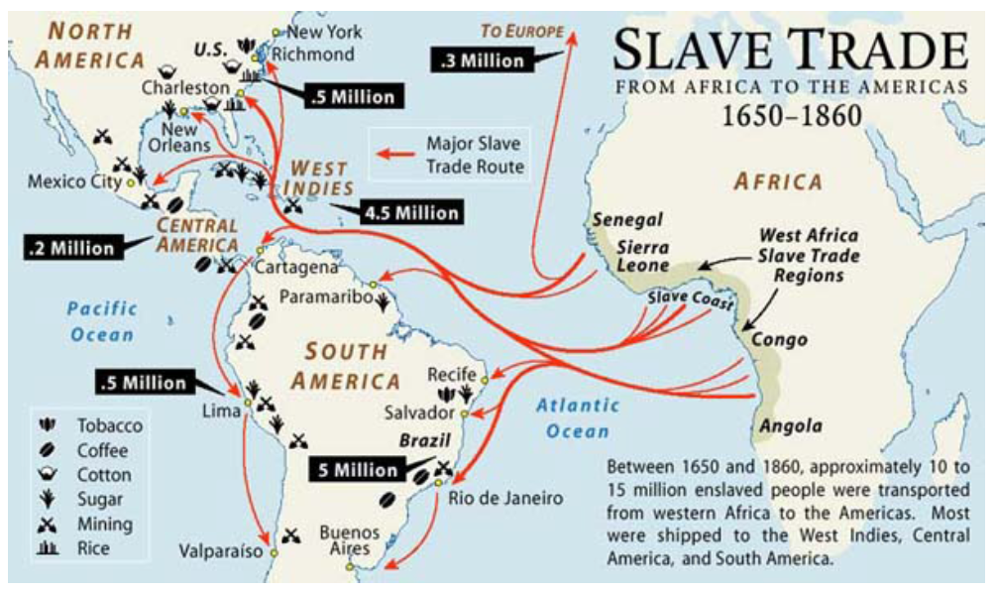
Slavery and Slave Revolts
Was slavery itself the cause of slave revolts?
Plantation Slavery: The Western Hemisphere

Slide 14
Comparative Perspectives on Slave Revolts
Frequency
Size
Success

Slide 15
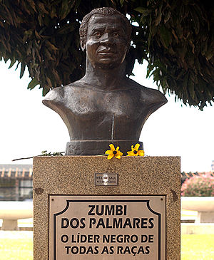
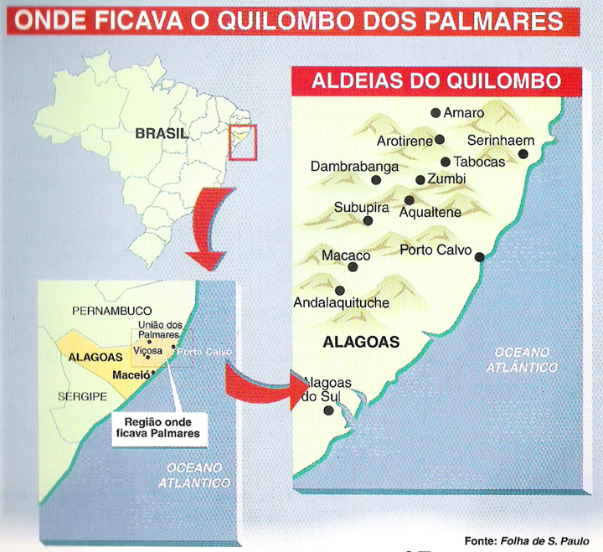
Quilombo of Palmares
Zumbi—Leader of Palmares Afro-Brazilian Community
Map Showing Location of Escaped Slave Quilombo 1605-1694

Slide 16
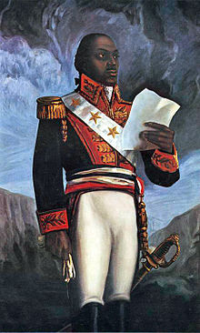
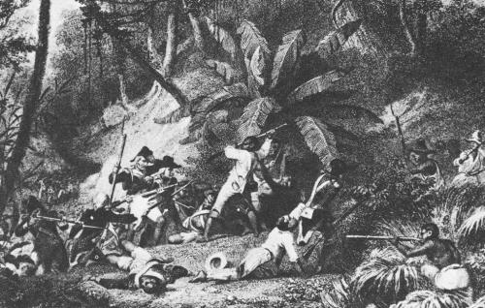
Haitian Revolution 1791-1804
Toussaint L’Ouverture

Slide 17
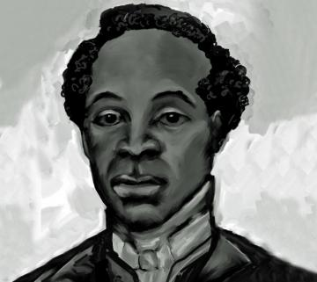
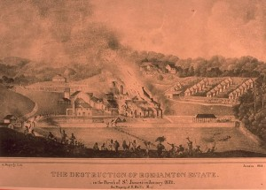
Jamaican Slave Revolt 1831
Rebels Attack a Plantation
Sam Sharpe Revolt Leader

Slide 18
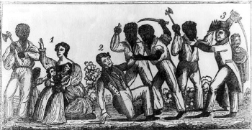
U.S. Rebellions before Nat Turner: Stono Rebellion 1739
Colonial North America: Stono Rebellion, South Carolina 1739

Slide 19
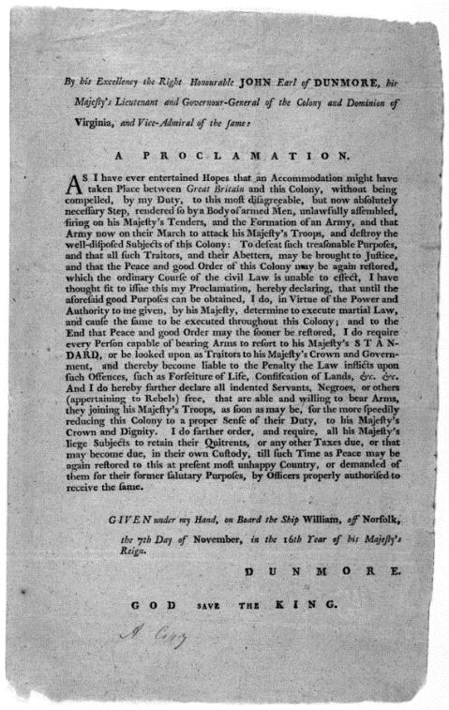
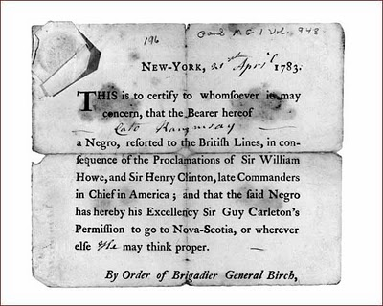
American Revolution and Slave Escape and Resistance
1775 British General Lord Dunmore’s Proclamation offers freedom to slaves who escape and join British troops
Escape, manumission and—in the North—gradual abolition of slavery.

Slide 20
Gabriel’s Rebellion, Richmond, VA 1800
Gabriel Prosser’s Conspiracy
Portrait of Gabriel Prosser
Prosser a literate, skilled blacksmith
Plan to march on Richmond
Heavy rains wash out bridge
Capture and repression
Influence of American and Haitian Revolutions
At trial, one slave reportedly says, "I have nothing more to offer than what General Washington would have had to offer, had he been taken by the British....”
2007: Virginia Governor pardons Gabriel Prosser

Slide 21
Denmark Vesey Rebellion, Charleston, SC, 1822
Vesey had purchased his own freedom after winning a lottery
Aware of ongoing political debates about expansion of slavery
Told followers that “children of Israel were delivered out of Egypt from bondage.”
Plot betrayed? Or fabricated by extremist white slaveowners?
Denmark Vesey Memorial

Slide 22
Explaining Differences: The Elkins Thesis
About fifty years ago, historian Stanley Elkins (in his book simply entitled Slavery) presented a controversial theory about why the U.S. South had fewer and smaller revolts than the rest of the Western Hemisphere.
The Slave South as “unopposed capitalist” society
Slavery as a “total institution”
Psychological impacts
Reception and Debate

Slide 23
Explaining Differences: More Recent Approaches
Demography
Geography
Escape potential
Arms? Larry Ward, chairman of “Gun Appreciation Day,” January 2013: "I think Martin Luther King, Jr. would agree with me if he were alive today that if African Americans had been given the right to keep and bear arms from day one of the country’s founding, perhaps slavery might not have been a chapter in our history."

